Slide 1
ALLOIMMUNIZATION IN SCD
Enosolease, ME. M:BS., FMCPath
Dept of Haematology, UBTH/School of Medicine, UNIBEN
BBMT 1st Annual Scientific Workshop/Conference
July15-27, 2013

Slide 2
Outline
SCD- Introduction
Transfusion in SCD
Alloimmunization
DHTR
Summary
Conclusion

Slide 3
SCD: Introduction
SCD is the commonest haemoglobinopathy in Nigeria
Characterised by chronic anaemia, various crises and chronic organ damage
Chronic RBC transfusion is often necessary
Chronic Blood tx could → multiple complications including alloimmunization
Blood transfusion is not curative
HSCT is for now the ONLY curative therapy
Chronic transfusion may interfere with the success of HSCT

Slide 4
RBC transfusion in SCD
No established guidelines in Nigeria
The decision to begin tx must be based on proven inability to compensate for low Hb conc. Such as:
* increased cardiac efforts- tachycardia, sweating, breathlessness at rest
Perceived replacement of sickle cells would alleviate symptoms

Slide 5
Transfusion in SCD
Most patients would have had transfusions as they get older for various indications
RBC transfusion is regarded as critically important during acute life threatening events: acute chest syndrome, stroke, splenic sequestration
Severe unrelenting VOC
Repeated VOC events →vessels endothelial damage, severe lung damage, cerebral vasculature, kidney and bones

Slide 6
Alloimmunization- Definition
Alloimmunization maens formation of antibodies against non-self antigens in same specie. RBC alloimmunization, therefore, is the development of antibodies against donor (allogeneic) RBCs antigens. They are recognised only because they cause haemolytic transfusion reactions of variable clinical significance.

Slide 7
Alloimmunization
ABO antigens elicit the most devastating haemolytic transfusion reactions
Together with RhD, ABO antigens are the most immunogenic RBC antigens of clinical importance
All blood banks type and match for ABO and RhD hence pose little or no problem
Other minor antigens are usually (routinely) not matched
Despite this only 2.6-2.9% may form alloAb in the general population (Heddle NM et al, BR J Haematol 1995;1000-5)

Slide 8
Alloimmunization-minor RBC Antigens
All rbc antigens are potentially immunogenic
Only few are considered clinically important: C, E,c, e Kell and Kidd, relatively less S (MNS) are found in 95% of cases (Vichinsky EP et al Transfusion 2001;41:1086-92)
Thus, matching for these in SCD reduces alloim
When unmatched for these Ags
7.5-17.6% (children≤ 10yrs)
18.6-35% of adults develop alloantibodies (Rosse et al Blood. 1990; 32:1617-21)

Slide 9
Alloimmunization
Despite matching for C,E, e,c Kell, Kidd antigens, some patients still develop alloantibodies.
REASONS:
-Not practicable to capture all nuisance antigens
-Low titre Abs may not be detected
-New Abs may be formed
-Other non-RBC antibodies (minor HLA antigens)

Slide 10
Alloimmunization: Non-RBC Antigens
Trace amount of HLA class-I mol are detected on rbc membrane causing HLA alloimm (Revera et al HLA Antigens on RBC. Implication for achieving Low HLA Content in Blood Transfusiom.Transfusion1986; 26: 375-81)
Bennet-Goodspeed Ag (group of rbc Ags normally not detected on screening) elicit HLA alloantibodies
Bg Ags have near identical homology with HLA B7,B57, B58 and HLA-A2, A28
Important in haemolysis, ? Effects on HSC engraftment/rejection

Slide 11
Non-RBC Antigens
WBC carry HLA ags – Leucodepletion
Platetlets also carry HLA antigens, plts transfusion can be an issue in HSCT

Slide 12
HLA Alloimmunization: Consequences
HLA alloantibodies may result in:
Transplant delayed grafting/rejection
Platelets refractoriness ( HSCT patients will normally receive multiple transfusions of platelets) Severe bleeding may be a serious challenge
Haemolysis of rbcs

Slide 13
Reducing HLA Alloimmunization
Screen for HLA alloatibodies in donors who have had blood transfusion or preganacy
Rescreen after transplant
Maximum HLA matching; molecular method is superior to serological techniques
High titre HLA antibodies (PRA –percentage of panel reactive antibodies) eg 80% is an absolute contraindication for donation of tissue/organ.(McPherson M et al Transfusion management of Sickle Cell Patients During Bone Marrow Transplantation in Sibling Matched Donors. Transfusion 2009)
The incidence of severe complications due to HLA alloabodies is unknown

Slide 14
SCD and Alloimmunization- Rates
Various reports from N. America:
14.4% in one, 8-36% in another
Wendell and Rosse (Blood) ASH Cooperative Study for SCD observed the following:
1.18.6% alloimm in 1814 SCD patients
2.Alloabs increase with increasing units of blood transfused
3. Rate of alloimmunization is lower in other haemoglobinopathies such HbSC, HbSβ+, thalassaemia

Slide 15
SCD and Alloimmunization- Rates
Women are more prone than men
45% is single antibody specificity, 17% have 4 or more antibodies
Antibodies to C, E, Kell and Lewis were the most common
(ASH: Review look back. Blood. 1990 76:1431-1437. Blood Hematol.org 18/07/2013)
The above findings might be useful in formulating policy guidelines for transfusion in SCD

Slide 16
Another ASH (CSSCD) studied 3047 SCD patients in a 5-yr period
Typed antibodies include:
*Anti-D, C,E, c,e Anti-f, Anti-V, Anti-C” M,N,S, AntiU, K, Kp, AntiJs, AntiJsb, AntiFya, Fy’ Fy3, Anti-Jk, Anti-Le” AntiLb, Anti-P, Anti-Sd, Anti-Wr” antiCob.
*Again, more sensitisations were seen in HBSS than others

Slide 17
(CSSCD) studied 3047 SCD patients in a 5-yr period
*Sensitisation increased with age
*Females (52%) received more transfusions
*Alloantibodies are more in females
*Alloimmunization in HBSS was 13.% cf to others, 9.1%
*35% of antibodies initially detected disappeared on subsequent testing (transient antibody eg Anti-Lau)

Slide 18
Other Studies
Jamaica 2.6%
Uganda 6.1%
These finding are substantially diff.from those of N. America
Incidence same (1-6%) as in the general population of these countries
Reasons: Homogeneity, poor blood availability, ?better understanding of disease process

Slide 19
Other Reasons for Alloimmu
Partial antigen
Weak antigens
Low incidence antigens
High incidence antigens
Individual susceptibility
Presence of chronic inflammatory stimulations
Autoantibody formation consequent upon alloimmunization

Slide 20
Consequences of Alloimm in SCD
May occur in 4-60%
Delay in patients care(difficulty getting matched donors)
Increased morbidity of organ/tissue transplants
Significant negative impact on staff and facilities
The real problem is DHTR

Slide 21
Delayed Haemolytic transfusion Reactions in SCD
DHTR in SCD is unpredictable.
May be mild and of no consequence except for poor Hct response to transfusion
May simulate VOC
Occurs several days/weeks after tx (5-15days, sometimes weeks).

Slide 22
Features of DHTR in SCD
Drop in hct due to destruction of transfused and autologous cells
Worsening anaemia, may be life threatening
(difficulty finding matched red cells)
Further transfusion may actually worsen condition
Profound reticulocytopenia
Exacerbation of sickle cell disease symptoms

Slide 23
Mechanism of DHTR in SCD
Poorly understood
Antibodies not detected at initial testing (low titre)
Re-stimulation (anamnestic response) results in rebound antibody formation
Inflammatory receptor cells secret cytokines that can activate effector cells such as NK, ?HLA ab preferentially activating humoral CD4 cells (Th2)
The role WBC/Platelets (leukocytosis/thrombocytosis) vessel endoth injury

Slide 24
Clinical and Biological Characteristics of AlloAb in DHTR
New antibodies and or additional antibodies are found
Frequently encountered antibodies-C, E, Fya, Jka and S. Some D (Rh) variants are common
Multiple antibodies in ≥ 50%
Diagnosis is frequently missed because it simulates VOC
Occurs several days/weeks after transfusion

Slide 25
Management
Mgx is controversial (because of poor understanding of mechanism)
Try to identify the offending antibody(ies)
?Steroid
IVIg
Rituximab esp if patient is known to be immunised
?Erythropoietin

Slide 26
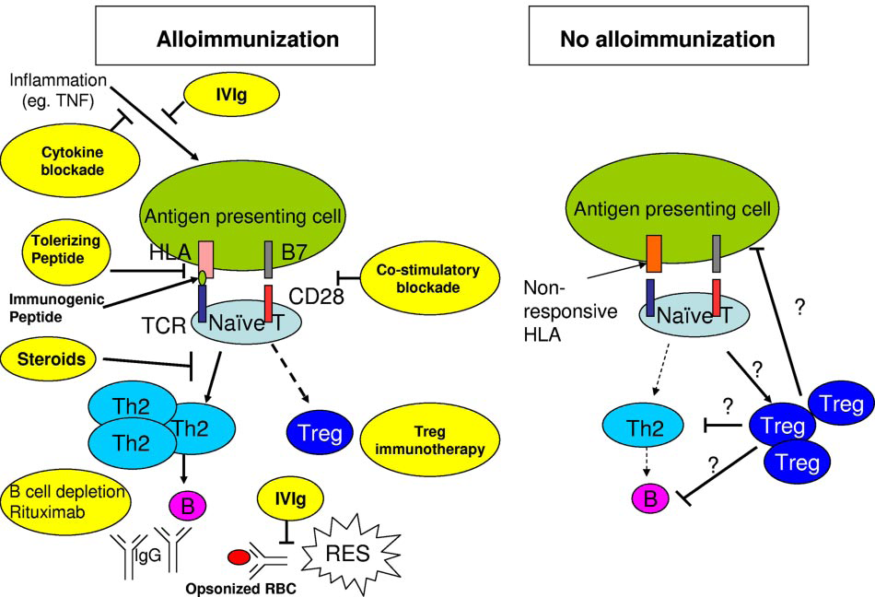
Schema to Immune Response to RBC Ag

Slide 27
See slide # 25
Figure 1. Hypothetical schema of immune response to RBC antigens in alloimmunized versus nonalloimmunized patients. Multiple participants in alloimmunization
versus no alloimmunization states are outlined. Preventive interventions and the specific steps in prevention of alloimmunization are shown in yellow. In addition, the possible
modes of action of steroids and IVIg for treatment of DHTR are also shown in yellow. The hypothetical model predicts that the chronic inflammatory state in SCD creates a
microenvironment with increased inflammatory cytokines, which favors antigen-presenting cells (APCs), such as macrophages and dendritic cells to increase consumption of
the transfused allogenic RBCs, and also favor generation of immunogenic peptides in APCs. The person’s HLA repertoire will then dictate whether these peptides are
presented to the naive CD4 T helper (Th) cells or not. Alloimmunized sickle patients have increased Th2 frequency, normally associated with humoral immune response, or
decreased Treg activity associated with alloimmunization. The skewing toward Th2 or decreased Treg is proposed to be associated with B-cell activation and antibody
production. In SCD patients who may have a genetic predisposition to be nonresponders, or patients who do not produce antibodies after allogeneic transfusions, the APCs
may be less immunostimulatory such that the peptides presented to the naive CD4 cells are tolerizing and result in the induction of Tregs that can reduce Th2 and/or B cell and
(BLOOD. First Edition paper. May4, 2012. DOI 10.1182/Blood-2011-11-32761)

Slide 28
Summary
Alloimmunization is commoner in SCD
Incidence depends on age, units transfused
Incidence varies widely
Common offenders are RH C,E c,e D-variant,
Kell, Kidd, S and Duffy
DHTR is the most devastating (Hyperhaemolytic suyndrome)
Others- plt refractoriness, graft rejection
May cause rejection HSCT
Adequate preventive measures though cost implicative are possible.

Slide 29
Conclusion
There are challenges in the diagnosis and screening for myriads of rbc/HLA antigens capable of causing clinically important alloimmunization in SCD individuals.
The cost in time, personnel and funds in transfusion practice, AND now in the new era of HSCT in Nigeria will be frustrating and unquantifiable. Effort must be made to select only those lacking these nuisance antigens for HSCs donations to avoid unwarranted rejection.

Slide 30
Thank you for your attention
Bha bionmon

