Slide 1
CARE OF CENTRAL VENOUS
CATHETER
SNO IMAFIDON E.O (Mrs)
July, 2013.

Slide 2
INTRODUCTION
Health care institutions and their patients are familiar with the effects of nosocomial infections (NI).
These consequences translate to the increased suffering and extension of recovery time for the patients and diminished indices of quality among institutions.

Slide 3
Central Venous Catheter (CVC) related blood stream infections are costly and account for a significant proportion of hospital acquired infections.
Patients for Hematopoietic stem cell transplantation are an exceptional high risk group considering their illness and severity of treatment, which demand a CVC.
The safety of the patients concerning this device depends mostly on the nursing care.

Slide 4
The nurses in UBTH Stem Cell Unit adopted a method whereby all those handling the CVC were taught and educated on the care of CVC as follows:
After the insertion of the Hickman Catheter in the isolation ward by the Cardiothoracic surgeon (CTU)
Wash and disinfect your hands with 70% alcohol
Wear your gowns, mask, gloves.
Enter the patient’s room (Isolation Room)
Disinfect your hands again.

Slide 5
Measure the length of the Hickman’s catheter. The connection of the CVC to the infusion line is usually covered with a sterile gauze to prevent the patient from:
Being hurt
To keep it clear
To prevent patient from disconnecting it
The dressing is changed daily by the trained nurse, but with the use of 2% Chlorhexidine gluconate dressing is changed weekly

Slide 6
The infusion lines are changed every 24 hours
Disinfect the infusion lines with sterile guaze and 70% alcohol daily.
When blood samples are collected flush the lines with heparinised saline to keep patent and prevent it from blocking or patient is on 24 hours Heparin infusion (0.9% normal saline)
Clean the cap with 70% alcohol before connecting the 3 ways valve.

Slide 7
The CVC must be handled with sterile gloves
The Hickman’s catheter comes either in one, two or three lumens in three different colours.
The red cap is for blood and blood components and Chemotherapy drugs.
Blue cap for drugs that are not compatible with intravenous fluids.
White cap for total parenteral nutrition (TPN), if patient is not on TPN, it is plugged.
All these are done under Aseptic techniques.

Slide 8


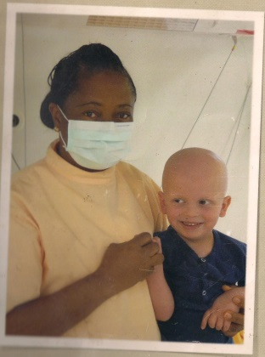
THE END
&
THANK YOU

