Slide 1


Dalteparin in the prevention of venous thromboembolism
Odofin Olufemi

Slide 2

CONTENT
Introduction
Risk factors for venous thromboembolism
LMWH for the prevention of VTE
  PREVENT study
  DIRECT study
Cancer and risk of VTE
  CLOT study
Recommendations, dosage, and method of administration

Slide 3
Dalteparin for prevention of VTE
Internal Medicine
Introduction
Risk factors for venous thromboembolism
LMWH for the prevention of VTE
  PREVENT study
  DIRECT study
Cancer and risk of VTE
  CLOT study
Recommendations, dosage, and method of administration

Slide 4
Venous thromboembolism (VTE)
High incidence¹:
  Incidence of DVT ≈2 million/year (USA)
  Incidence of PE: ≈600,000 /year(USA)
  VTE is often asymptomatic
  In patients with DVT, the incidence of PE is >50%
    Small emboli do not usually produce symptoms
    The majority of clinically significant PEs and virtually all fatal PEs come from the proximal veins
  PE is often fatal (5 to 10% of all hospital deaths)
Notes:
Venous thromboembolic disease is an umbrella term that encompasses deep-vein thrombosis, superficial vein thrombosis, and pulmonary embolism
For the purposes of our discussion, DVT and PE will constitute the bulk of the information shared
The important thing to remember is that DVT occurs approximately 2 million times per year and many DVTs are asymptomatic. This is important because even asymptomatic DVTs can propagate to become Pes, which can often be fatal
Some research has suggested that PE causes more than 200,000 deaths per year
References
1. Goldhaber SZ et al. Am J Cardiol. 2004;93:259-262
2. Geerts WH et al. Chest. 2008;133(Suppl):381S-453S. 3. Hirsh J, Hoak J. Circulation. 1996;93:2212-2245.
3 Hirsh J, Hoak J. Circulation. 1996;93:2212-2245.
FOR SPEAKER USE ONLY. DO NOT COPY, DISTRIBUTE, OR DISSEMINATE.

Slide 5
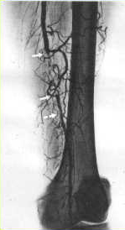
Venous thromboembolism (VTE)
Frequent cause of unexplained death:
  Most deep vein thromboses are asymptomatic or “subclinical” ^{2,3}
  Subclinical DVT is the principal cause of fatal pulmonary embolism⁴
  ~80% of deaths due to pulmonary embolism are only diagnosed on autopsy⁴
Notes:
FOR SPEAKER USE ONLY. DO NOT COPY, DISTRIBUTE, OR DISSEMINATE.

Slide 6
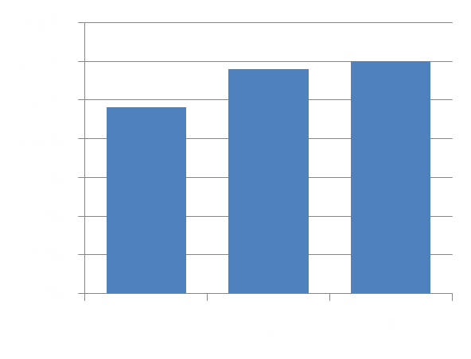
Consequence of VTEs
Cause of significant future morbidity:
Risk of post-thrombotic syndrome
  Risk of post-thrombotic syndrome ⁵
  Risk of recurrence of VTE for ≥ 8 years
  Long-term costs 12x higher than those of patients without VTE ⁶
Years after VTE
Notes:
FOR SPEAKER USE ONLY. DO NOT COPY, DISTRIBUTE, OR DISSEMINATE.

Slide 7
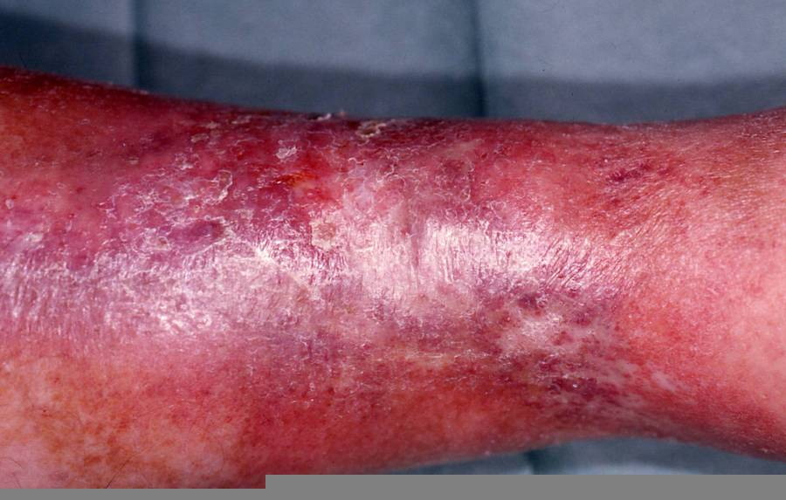
Consequence of VTEs
Cause of significant future morbidity:
Risk of post-thrombotic syndrome
  Risk of post-thrombotic syndrome ⁵
  Risk of recurrence of VTE for ≥ 8 years
  Long-term costs 12x higher than those of patients without VTE ⁶
Notes:
FOR SPEAKER USE ONLY. DO NOT COPY, DISTRIBUTE, OR DISSEMINATE.

Slide 8
VTE in hospitalized patients
It is not only a problem in surgical patients^{7,8}:
100
Surgery
Surgery
50-70% of symptomatic VTEs occur in non-surgical patients
70-80% of fatal PEs occur in non-surgical patients
In a screening study, DVT was detected by Doppler ultrasonography in 33% of the patients in an ICU
10% of hospital deaths are due to PE
80
Medical disease
60
Events (%)
Medical disease
40
20
0
Symptomatic VTE
Fatal PE

Slide 9

VTE in hospitalized patients
Epidemiologic International Day for the Evaluation of Patients at Risk for Venous Thromboembolism in the Acute Hospital Care Setting Study⁹
International (32 countries), cross-sectional survey, including hospitals with intensive care and with over 50 beds
Objectives:
  To evaluate the number of patients ≥40 years at risk of VTE, and,
  To determine the proportion who received prophylactic treatment for VTE
Notes:
ENDORSE (Epidemiologic International Day for the Evaluation of Patients at Risk for Venous Thromboembolism in the Acute Hospital Care Setting) study was a multinational, cross-sectional survey, designed to assess the number of patients aged ≥40 years at risk for VTE in the acute care hospital setting The goal of ENDORSE was to determine the proportion of these at-risk patients who received prophylaxis as recommended by the American College of Chest Physicians (ACCP) guidelines.^{1,2}
Data were collected from a review of hospital charts on standard case report forms, and included information on patients demographics, admission and post-admission diagnoses, risk factors associated with VTE, risk factors for bleeding, duration of stay and type of VTE prophylaxis.
Reference
1. Cohen AT, Tapson VF, Bergmann J-F, et al. Venous thromboembolism risk and prophylaxis in the acute hospital care setting (ENDORSE study): a multinational cross-sectional study. Lancet 2008; 371: 387–94.
2. Geerts WH, Pineo GF, Heit JA, et al. Prevention of venous thromboembolism: The Seventh ACCP Conference on Antithrombotic and Thrombolytic Therapy. Chest 2004; 126: 338S–400S.
9
FOR SPEAKER USE ONLY. DO NOT COPY, DISTRIBUTE, OR DISSEMINATE.

Slide 10
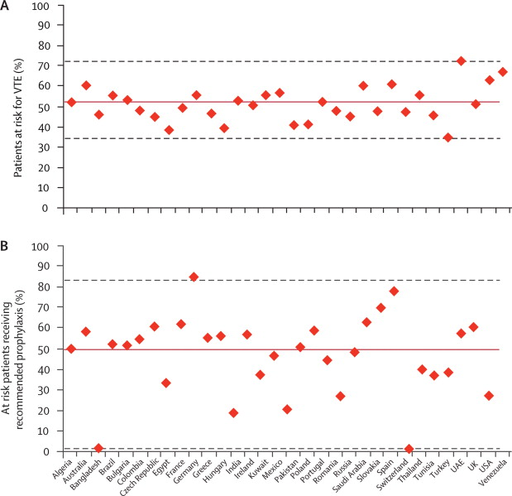
VTE in hospitalized patients
Patients at risk of VTE
Patients at risk of VTE who received prophylaxis
Notes:
ENDORSE (Epidemiologic International Day for the Evaluation of Patients at Risk for Venous Thromboembolism in the Acute Hospital Care Setting) study was a multinational, cross-sectional survey, designed to assess the number of patients aged ≥40 years at risk for VTE in the acute care hospital setting The goal of ENDORSE was to determine the proportion of these at-risk patients who received prophylaxis as recommended by the American College of Chest Physicians (ACCP) guidelines.1,2
Data were collected from a review of hospital charts on standard case report forms, and included information on patients demographics, admission and post-admission diagnoses, risk factors associated with VTE, risk factors for bleeding, duration of stay and type of VTE prophylaxis.
Reference
1. Cohen AT, Tapson VF, Bergmann J-F, et al. Venous thromboembolism risk and prophylaxis in the acute hospital care setting (ENDORSE study): a multinational cross-sectional study. Lancet 2008; 371: 387–94.
2. Geerts WH, Pineo GF, Heit JA, et al. Prevention of venous thromboembolism: The Seventh ACCP Conference on Antithrombotic and Thrombolytic Therapy. Chest 2004; 126: 338S–400S.
10
FOR SPEAKER USE ONLY. DO NOT COPY, DISTRIBUTE, OR DISSEMINATE.

Slide 11
Dalteparin for prevention of VTE
Internal Medicine
Introduction
Risk factors for venous thromboembolism
LMWH for the prevention of VTE
  PREVENT study
  DIRECT study
Cancer and risk of VTE
  CLOT study
Recommendations, dosage, and method of administration
Notes:
FOR SPEAKER USE ONLY. DO NOT COPY, DISTRIBUTE, OR DISSEMINATE.

Slide 12
Physiopathology of VTE
Risk of DVT
Low-medium risk
    Medium-high risk
    Very high risk
Venous stasis
Vascular lesion
Hypercoagulability
Virchow's triad

Slide 13
Risk factors for VTE¹⁰
Connected with the patient
  Age Principal risk factor
    Risk increases >40 years and even further >50-60 years
  Female sex
  Obesity
  Oral contraceptives ( ATIII,  factors II, VII, and X)

Slide 14
Risk factors for VTE¹⁰
In the context of surgery
  Prevalence of VTE:
    General surgery: 15-40%
    Major gynaecological surgery: 15-40%
    Major urological surgery: 15-40%
    Neurosurgery: 15-40%
    Thoracic/cardiothoracic surgery: 30-45%
    Orthopaedic surgery (arthroplasty of the hip/knee): 40-60%

Slide 15
Risk factors for VTE¹⁰
In the context of medical disease (10-20%)
  Previous venous thromboembolism
  Immobilization of the lower limbs (e.g. CVA)
  Pregnancy and puerperium
  Acute medical diseases (CVA, AMI, etc.) (20-50%)
  Major trauma (40-80%)
  Inflammatory bowel disease
  Nephrotic syndrome
  Myeloproliferative diseases
  Cancer
  Cancer treatment (hormonal, chemotherapy, radiotherapy)
  Erythropoiesis-stimulating agents (erythropoietin)
  Central venous catheterization
  Hereditary coagulation disorders

Slide 16
Risk factors for VTE¹⁰
Virchow's triad
Age
Immobilization
CVA
Anaesthesia
CHF
Surgery
Previous VTE
Venous accesses
Trauma
Vasculitis
Venous stasis
Vascular lesion
Hypercoagulability
Risk of DVT
Low-medium risk
    Medium-high risk
    Very high risk
Def. of protein C or S or ATIII
Carcinomas
Oestrogens
AAS, hyperhomocysteinaemia…

Slide 17
Stratification of risk of VTE¹¹
Thromboembolic Risk Factors Consensus Group (1992)
Level of risk | Risk factor
High risk DVT 40-80% Fatal PE 1-10% | Major surgery or orthopaedic surgery (pelvis, hip, leg) Major pelvic/abdominal surgery for cancer Major surgery, injury (e.g. of spinal cord), or medical disease in patients with a history of DVT, PE, or thrombophilia Paralysis of the lower limbs Severe ischaemia/amputation of lower limbs
Moderate risk DVT 10-40% Fatal PE 0.1-1% | General, gynaecological, urological, cardiothoracic, vascular, or neurological surgery in patients >40 years with one or more of the other risk factors Major acute medical disease (AMI, CHF, inflammatory bowel disease, cancer) Minor medical disease, injury, or surgery, in patients with a history of DVT, PE, or thrombophilia Immobilization of lower limb in plaster in a patient with a minor injury
Low risk DVT < 10% Fatal PE 0.01% | Major surgery (<30 min), <40 years, with no other risk factors Minor surgery, with no other risk factors Minor medical disease or injury, with no other risk factors

Slide 18
Stratification of risk of VTE¹²
American College of Chest Physicians Guidelines (2008)
Level of risk | Risk of VTE (without prophylaxis) | Recommended prophylaxis
Low risk Minor surgery in mobile patients Medical patients who are mobilized | <10% | No prophylactic treatment Early, “aggressive” ambulation
Moderate risk Majority of gynaecological or urological surgical interventions Medical patients confined to bed Moderate risk of VTE and high risk of haemorrhage | 10-40% | LMWH, LMW heparinoids, fondaparinux Mechanical prophylaxis
High risk Arthroplasty of hip/knee Major trauma, spinal-cord injury High risk of VTE and high risk of haemorrhage | 40-80% | LMWH, fondaparinux, vit. K antagonists Mechanical prophylaxis

Slide 19
Stratification of risk of VTE
Incidence of events according to level of risk²
Events | Level of risk (%)
 | Low | Moderate | High | Very high
Distal DVT | 2.0 | 10 – 20 | 20 – 40 | 40 – 80
Proximal DVT | 0.4 | 2 – 4 | 4 – 8 | 10 – 20
PE | 0.2 | 1 – 2 | 2 – 4 | 4 – 10
Fatal PE | 0.002 | 0.1 – 0.4 | 0.4 – 1.0 | 1 – 5

Slide 20
Dalteparin for prevention of VTE
Internal Medicine
Introduction
Risk factors for venous thromboembolism
LMWH for the prevention of VTE
  PREVENT study
  DIRECT study
Cancer and risk of VTE
  CLOT study
Recommendations, dosage, and method of administration
Notes:
FOR SPEAKER USE ONLY. DO NOT COPY, DISTRIBUTE, OR DISSEMINATE.

Slide 21
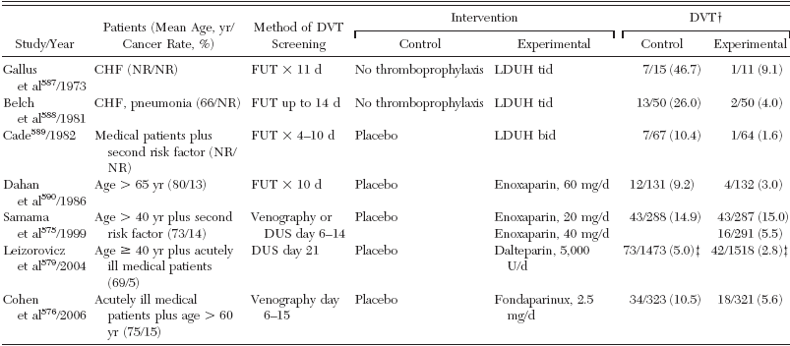
Prevention of VTE – acute medical diseases
  TRIALS ON PREVENTION OF VTE IN ACUTE MEDICAL DISEASES¹⁰
Notes:
FOR SPEAKER USE ONLY. DO NOT COPY, DISTRIBUTE, OR DISSEMINATE.

Slide 22
Prevention of VTE – acute medical diseases
  TRIALS ON PREVENTION OF VTE IN ACUTE MEDICAL DISEASES¹⁰
Notes:
FOR SPEAKER USE ONLY. DO NOT COPY, DISTRIBUTE, OR DISSEMINATE.

Slide 23
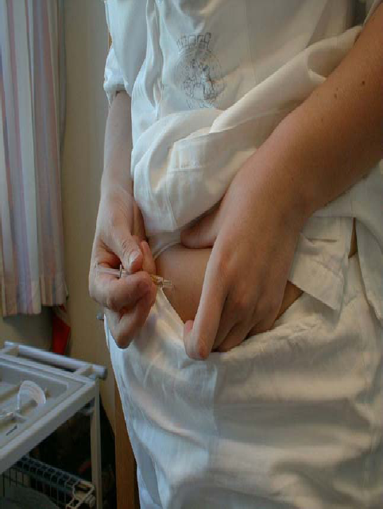
Why LMWH in the prevention of VTE?
Easy to use ¹³⁻¹⁶
  Anticoagulant response predictable
  No need for monitoring of the anticoagulation
  No need for dose-adjustment
  Self-administration possible
  Outpatient use possible
Lower risk of thrombocytopenia than with heparin ¹⁷
  <1% with dalteparin ¹⁸
  1.3% with enoxaparin ¹⁹
Notes:
FOR SPEAKER USE ONLY. DO NOT COPY, DISTRIBUTE, OR DISSEMINATE.

Slide 24
study²⁰
PREVENT
  PREVENT – Medical Thromboprophylaxis Study Group
  Controlled, randomized trial of dalteparin for prevention of venous thromboembolism in acute medical patients
  Objective: Efficacy and safety of dalteparin in comparison with placebo in the prevention of VTE in hospitalized medical patients
  Design: Randomized, double-blind, placebo-controlled, multicentre
  Population: 3706 patients with an acute medical disease
  Hospitalization ≥4 days
Notes:
FOR SPEAKER USE ONLY. DO NOT COPY, DISTRIBUTE, OR DISSEMINATE.

Slide 25
study²⁰
PREVENT
  Protocol
Treatment period
Follow-up period
Dalteparin
(n=1848)
(5000 IU/day s.c.)
Without treatment
Randomization
Placebo (n=1833)
(1x/day s.c.)
Without treatment
Day 14
Day 90
(evaluation)
Day 21 (evaluation)
Notes:
FOR SPEAKER USE ONLY. DO NOT COPY, DISTRIBUTE, OR DISSEMINATE.

Slide 26
study²⁰
PREVENT
  Initial characteristics
 | Dalteparin (n=1848) | Placebo (n=1833)
Mean age (years) | 68.5 | 68.5
Principal diagnosis (%)
CHF (NYHA class III-IV) | 52.2 | 51.3
Acute respiratory failure (without artificial respiration) | 30.4 | 30.6
Other acute conditions | 40.5 | 42.6
Infectious diseases (without septic shock) | 36.4 | 37.5
Rheumatological diseases | 10.8 | 10.8
Inflammatory bowel diseases | 0.5 | 0.4
Notes:
FOR SPEAKER USE ONLY. DO NOT COPY, DISTRIBUTE, OR DISSEMINATE.

Slide 27
study²⁰
PREVENT
  Initial characteristics
 | Dalteparin (n=1848) | Placebo (n=1833)
Risk factors (%)
Age ≥75 years | 33.1 | 33.6
Cancer | 4.6 | 5.7
Previous VTE | 3.4 | 4.4
Obesity | 30.2 | 30.6
Varicose veins | 26.4 | 28.9
Hormone therapy | 1.8 | 1.6
Chronic CHF | 50.1 | 51.6
Chronic respiratory failure | 9.5 | 10.0
Myeloproliferative syndrome | 0.3 | 0.5
Notes:
FOR SPEAKER USE ONLY. DO NOT COPY, DISTRIBUTE, OR DISSEMINATE.

Slide 28
study²⁰
PREVENT
  Results - Efficacy
Primary endpoint
RRR=45% (p=0.0015)
6
5.0
RRR=52%
5
Placebo
Dalteparin
4
3.7
3
2.8
Incidence (%)
RRR=30%
2
1.8
1.3
1
0.9
0
Sudden death or VTE (D21)
Asymptomatic proximal DVT (D21)
Symptomatic VTE
(D90)
Notes:
FOR SPEAKER USE ONLY. DO NOT COPY, DISTRIBUTE, OR DISSEMINATE.

Slide 29
study²⁰
PREVENT
  Efficacy – Subgroup analysis
Dalteparin better
Placebo better
Congestive heart failure
Acute respiratory failure
Other acute diseases
Age >75 years
Age <75 years
Male
Female
Total population
RR
0.1
0.55
1
10
Notes:
FOR SPEAKER USE ONLY. DO NOT COPY, DISTRIBUTE, OR DISSEMINATE.

Slide 30
PREVENT
study²⁰
  Results - Safety
 | Dalteparin (n=1848) | Placebo (n=1833)
Mortality Day 14 | 0.43% | 0.38%
Day 21 | 2.35% | 2.32%
Major haemorrhages Day 14 | 0.4% | 0%
Day 21 | 0.5% | 0.2%
Minor haemorrhages Day 14 | 0.87% | 0.27%
Day 21 | 1.03% | 0.55%
Thrombocytopenia Day 14 | 0.54% | 0.33%
Day 21 | 0.54% | 0.44%
Notes:
FOR SPEAKER USE ONLY. DO NOT COPY, DISTRIBUTE, OR DISSEMINATE.

Slide 31
study²⁰
PREVENT
  Conclusions:
  Dalteparin 5000 IU/day for 14 days significantly reduces the risk of VTE in comparison with placebo, without a significant increase in the risk of haemorrhage
  Venous thromboprophylaxis must be considered in all medical patients with restricted mobility during an acute medical disease
Notes:
FOR SPEAKER USE ONLY. DO NOT COPY, DISTRIBUTE, OR DISSEMINATE.

Slide 32
study²¹
DIRECT
  DIRECT - Canadian Critical Care Trials Group
  Prevention of deep vein thrombosis using the low-molecular-weight heparin dalteparin in patients with an acute medical disease and severe renal failure
Rationale:
  Use of LMWH is avoided in patients with kidney failure on account of a fear of excessive anticoagulation and an increase in the risk of haemorrhage
  Patients with kidney failure have been systematically excluded from the studies of LMWH
  Patients hospitalized in ICUs are at increased risk of a VTE, even under prophylactic treatment with UFH
Notes:
FOR SPEAKER USE ONLY. DO NOT COPY, DISTRIBUTE, OR DISSEMINATE.

Slide 33
study²¹
DIRECT
However:
  Evidence that dalteparin accumulation occurs only at therapeutic doses (and not at prophylactic doses)
  Evidence that administration of prophylactic doses of LMWH in patients with kidney failure appears to be safe
  Preliminary evidence that dalteparin does not accumulate in ICU patients with kidney failure
Notes:
FOR SPEAKER USE ONLY. DO NOT COPY, DISTRIBUTE, OR DISSEMINATE.

Slide 34
DIRECT
study²¹
  Objective: To evaluate the safety (excessive anticoagulant effect measured by anti-Xa activity) of dalteparin in ICU patients with severe kidney failure
  To evaluate efficacy (incidence of VTE, evaluated by Doppler ultrasonography)
  Design: Prospective, open, single-arm, multicentre
  Population: 156 patients in an ICU for >72 h
  Severe kidney failure (creatinine clearance <30 ml/min)
Notes:
FOR SPEAKER USE ONLY. DO NOT COPY, DISTRIBUTE, OR DISSEMINATE.

Slide 35
study²¹
DIRECT
  Results
    Mean duration of treatment with dalteparin: 7 (4-12) days
    Mean creatinine value At start: 18.9 ± 6.4 ml/min
      At end: 28.4 ± 17.3 ml/min
  EFFICACY
    Asymptomatic proximal DVT: 7 cases (5.1%, 95% CI 2.5%-10.2%)
    DVT associated with central catheter: 6 cases
    PE: no cases
Notes:
FOR SPEAKER USE ONLY. DO NOT COPY, DISTRIBUTE, OR DISSEMINATE.

Slide 36
study²¹
DIRECT
  Results
  SAFETY
No patients (0%, 95% CI 0-3%) showed evidence of bioaccumulation of dalteparin (evaluated from anti-Xa activity levels, which were minimal or undetectable at trough in 99% of cases)
Major haemorrhage: 10 cases (7.2%, 95% CI 4.0%-5.1%), 2 fatal (all with undetectable anti-Xa levels)
HIT: 2 cases (1.4%, 95% CI 0.4%-5.1%)
(both with previous exposure to UFH)
Notes:
FOR SPEAKER USE ONLY. DO NOT COPY, DISTRIBUTE, OR DISSEMINATE.

Slide 37
study²¹
DIRECT
  Conclusions
These data challenge the premise that DVT prophylaxis using LMWH must be avoided in patients with severe kidney failure
    They can probably be extended to less severely ill patients
    They can probably be extended to patients with mild or moderate kidney failure
The relatively high incidence of major haemorrhages (7%) was not connected with anti-Xa activity levels and probably reflects the severity of the illnesses of hospitalized patients
Dalteparin 5000 IU/day seems a reasonable option for the prevention of DVT in patients with severe kidney failure
Notes:
FOR SPEAKER USE ONLY. DO NOT COPY, DISTRIBUTE, OR DISSEMINATE.

Slide 38
Dalteparin for prevention of VTE
Internal Medicine
Introduction
Risk factors for venous thromboembolism
LMWH for the prevention of VTE
  PREVENT study
  DIRECT study
Cancer and risk of VTE
  CLOT study
Recommendations, dosage, and method of administration
Notes:
FOR SPEAKER USE ONLY. DO NOT COPY, DISTRIBUTE, OR DISSEMINATE.

Slide 39
Prevention of VTE in oncology¹⁰
  Rationale
  In patients with cancer, the risk of VTE is increased by a factor
  of 6
  VTE is a common complication in cancer patients and significantly reduces their life expectancy
  Cancer is responsible for 20% of all VTEs
  In cancer patients who undergo surgery, the risk of VTE is increased by a factor of >2
  In cancer patients who suffer a VTE, the rate of recurrence is very high, even with anticoagulant therapy
Notes:
FOR SPEAKER USE ONLY. DO NOT COPY, DISTRIBUTE, OR DISSEMINATE.

Slide 40
Prevention of VTE in oncology
Probability of death in the first 183 days after initial hospital admission²²
1.0
0.8
0.6
0.4
0.2
0.0
DVT/PE and malignant disease
Probability of death
Malignant disease only
0 40 80 120 180
Number of days
Levitan N et al, Medicine (Baltimore). 1999 Sep;78(5):285-91.
Notes:
This slide merely demonstrates that patients with concurrent DVT/PE and malignancy have a more than threefold higher risk of recurrent thromboembolic disease and death than patients with DVT/PE without malignancy
Multiple randomized trials in a variety of patient populations conducted in the last 30 years demonstrate that primary prophylaxis of for VTE disease can reduce the rate of DVT, PE, and fatal PE
However, robust clinical trials proving that treatment of DVT or PE with antithrombotic agents have a benefical impact on cancer-realted survival have not been performed
Despie the fact that there is an undeniable link between cancer and thrombosis, research is still needed that ultimately shows that proper prophylaxis or treatment can have a beneficial effect on survival
Reference
1. Levitan N et al, Medicine (Baltimore) 1999 Sep;78(5):285-91
FOR SPEAKER USE ONLY. DO NOT COPY, DISTRIBUTE, OR DISSEMINATE.

Slide 41
Prevention of VTE in oncology
Virchow's triad
Tumour invasion
Chemotherapy
Central venous catheters
Immobilization
External compression
Venous stasis
Vascular lesion
Hypercoagulability
Risk of DVT
Low-medium risk
    Medium-high risk
    Very high risk
Procoagulants
 Antithrombin III
 Protein C

Slide 42

study²³
CLOT
  Randomized Comparison of Low-Molecular-Weight Heparin versus Oral Anticoagulant Therapy for the Prevention of Recurrent Venous Thromboembolism in Patients with Cancer (CLOT) Investigators
  Low-molecular-weight heparin versus warfarin in the prevention of recurrent venous thromboembolism in patients with cancer
  Objective: Efficacy of dalteparin in comparison with warfarin for the prevention of recurrence of VTE in patients with cancer
  Design: Randomized, controlled, open label
  Population: 676 cancer patients
  Acute symptomatic DVT and/or PE
Notes:
FOR SPEAKER USE ONLY. DO NOT COPY, DISTRIBUTE, OR DISSEMINATE.

Slide 43
study²³
CLOT
  Protocol:
Treatment period
Follow-up period
Day 5-7
Day 180
OAC (INR 2.5)
(n=338) +
Dalteparin
(200 IU/kg/day s.c. )
OAC (INR 2.5)
Randomization
Dalteparin
(200 IU/kg/day s.c. )
(n=338)
Dalteparin
(~150 IU/kg/day s.c. )
Day 30
Day 180
Notes:
Venous thromboembolic disease is an umbrella term that encompasses deep-vein thrombosis, superficial vein thrombosis, and pulmonary embolism
For the purposes of our discussion, DVT and PE will constitute the bulk of the information shared
The important thing to remember is that DVT occurs approximately 2 million times per year and many DVTs are asymptomatic. This is important because even asymptomatic DVTs can propagate to become Pes, which can often be fatal
Some research has suggested that PE causes more than 200,000 deaths per year
References
1. Goldhaber SZ et al. Am J Cardiol. 2004;93:259-262
2. Geerts WH et al. Chest. 2008;133(Suppl):381S-453S. 3. Hirsh J, Hoak J. Circulation. 1996;93:2212-2245.
3 Hirsh J, Hoak J. Circulation. 1996;93:2212-2245.
FOR SPEAKER USE ONLY. DO NOT COPY, DISTRIBUTE, OR DISSEMINATE.

Slide 44
study²³
CLOT
  Results – Primary efficacy endpoint
25
HR = 0.48 (0.30 - 0.77), p = 0.002
Probability of
VTE recurrence (%)
20
16%
15
OAC
10
8%
Dalteparin
5
0
0
30
60
90
120
150
180
210
Days
Notes:
FOR SPEAKER USE ONLY. DO NOT COPY, DISTRIBUTE, OR DISSEMINATE.

Slide 45
study²³
CLOT
  Results – Primary efficacy endpoint
25
RRR = 52%, p = 0.002
Probability of
VTE recurrence (%)
20
16%
15
OAC
10
8%
Dalteparin
5
0
0
30
60
90
120
150
180
210
Days
Notes:
FOR SPEAKER USE ONLY. DO NOT COPY, DISTRIBUTE, OR DISSEMINATE.

Slide 46
study²³
CLOT
  Results – subgroup analysis
Dalteparin better
OAC better
 | RR | 95% CI | n
COX model | 0.51 | (0.32 ,0.81) | 676
Type of tumour
Solid tumour | 0.45 | (0.28, 0.71) | 606
Breast | 0.83 | (0.12, 5.68) | 108
Gastrointestinal | 0.54 | (0.23, 1.26) | 164
Lung | 0.35 | (0.14, 0.85) | 90
Genitourinary | 0.41 | (0.13, 1.24) | 155
Other | 0.59 | (0.22, 1.63) | 89
Blood | 6.80 | (0.38, 121.74) | 70
Extent of the cancer
Without metastases | 0.43 | (0.27, 0.71) | 455
With metastases | 0.61 | (0.15, 2.45) | 151
Notes:
Please consult Core Data Sheet which represents the global safety information
Please consult local labeling for all prescribing information as indications may vary
FOR SPEAKER USE ONLY. DO NOT COPY, DISTRIBUTE, OR DISSEMINATE.

Slide 47
study²³
CLOT
  Safety – haemorrhagic events
Event | Dalteparin (n=338) | OAC (n=335) | p value
Major haemorrhage | 6% (19/338) | 4% (12/335) | 0.27
Any haemorrhage | 14% (46/338) | 19% (62/335) | 0.09
Notes:
Please consult Core Data Sheet which represents the global safety information
Please consult local labeling for all prescribing information as indications may vary
FOR SPEAKER USE ONLY. DO NOT COPY, DISTRIBUTE, OR DISSEMINATE.

Slide 48
study²³
CLOT
  Conclusions:
Dalteparin administered once a day for 6 months to patients with cancer and with a documented VTE episode:
  Significantly reduces the risk of recurrence of VTE in comparison with oral anticoagulant therapy
  Does not significantly increase the risk of haemorrhage in comparison with oral anticoagulant therapy
Notes:
FOR SPEAKER USE ONLY. DO NOT COPY, DISTRIBUTE, OR DISSEMINATE.

Slide 49
Dalteparin for prevention of VTE
Internal Medicine
Introduction
Risk factors for venous thromboembolism
LMWH for the prevention of VTE
  PREVENT study
  DIRECT study
Cancer and risk of VTE
  CLOT study
Recommendations, dosage, and method of administration

Slide 50

Recommendations of 8th ACCP (2008)
Prophylactic treatment of VTE in hospitalized patients¹⁰
Medical patients:
  Hospitalized for CHF
  Hospitalized for respiratory failure
  Confined to bed
  With 1 additional risk factor *
LMWH
* Additional risk factors: cancer, previous VTE, sepsis, acute neurological disease, inflammatory bowel disease

Slide 51
LMWH for the prophylaxis of VTE
 | Fragmin® Dalteparin | Lovenox® Enoxaparin | Fraxiparin® Nadroparin | Innohep® Tinzaparin
Treatment of DVT and PE |  |  |  | 
Prevention of VTE after general/orthopaedic surgery |  |  |  | 
Prevention of VTE in acute medical diseases |  |  |  | 
Prevention of VTE in patients with kidney failure |  | * | * | *
Secondary prevention of VTE in patients with cancer |  | - | - | -
* Dose-adjustment necessary
Notes:
FOR SPEAKER USE ONLY. DO NOT COPY, DISTRIBUTE, OR DISSEMINATE.
51
This slide further reiterates the fact that routine medical interventions performed on cancer patients can be a causative factor in VTE disease
Most notable is the fact that routine cancer surgery can increase the risk of VTE in cancer patients by 20% to 40%²
Additionally, central venous catheterization, immobilization, and chemotherapy all compound the risk of VTE.
References
1. Hillen HF. Thrombosis in cancer patients. Ann Oncol. 2000;11(Suppl):273-276.
2. Kakkar AK, Williamson RC. Prevention of venous thromboembolism in cancer patients. Semin Thromb Hemost. 1999;25:239-243. .

Slide 52
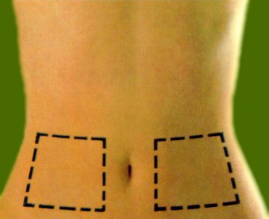

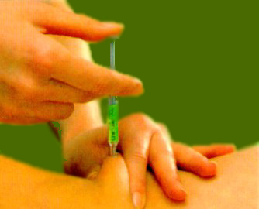
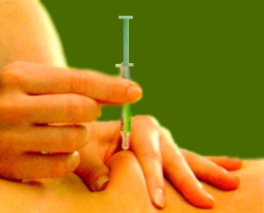
Dalteparin - method of administration
Administration by the subcutaneous route (intravenous route only in haemodialysis)
Areas for injection
Formation of a fold
Injection
Withdrawal of needle
Notes:
FOR SPEAKER USE ONLY. DO NOT COPY, DISTRIBUTE, OR DISSEMINATE.

Slide 53
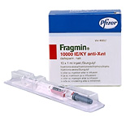
Dalteparin – available doses
Prefilled syringes
Presentation | ml | Dilution | 1 ml of solution contains | Total content of container
Prefilled syringe | 0.2 ml | 2500 IU/0.2 ml | 12,500 IU | 2500 IU
Prefilled syringe | 0.2 ml | 5000 IU/0.2 ml | 25,000 IU | 5000 IU
Prefilled syringe | 0.3 ml | 7500 IU/0.3 ml | 25,000 IU | 7500 IU
Prefilled syringe | 0.4 ml | 10,000 IU/0.4 ml | 25,000 IU | 10,000 IU
Prefilled syringe | 0.5 ml | 12,500 IU/0.5 ml | 25,000 IU | 12,500 IU
Prefilled syringe | 0.6 ml | 15,000 IU/0.6 ml | 25,000 IU | 15,000 IU
Notes:
FOR SPEAKER USE ONLY. DO NOT COPY, DISTRIBUTE, OR DISSEMINATE.

Slide 54
DOSAGE
  PREVENTION OF VTE COMPLICATIONS CONNECTED WITH SURGERY
  General Surgery
  Patients at moderate risk of VTE
  2500 IU s.c. 2 h before the intervention
  2500 IU s.c. per day on the following days
  (until the patient gets moving, generally 5-7 days)
Notes:
Venous thromboembolic disease is an umbrella term that encompasses deep-vein thrombosis, superficial vein thrombosis, and pulmonary embolism
For the purposes of our discussion, DVT and PE will constitute the bulk of the information shared
The important thing to remember is that DVT occurs approximately 2 million times per year and many DVTs are asymptomatic. This is important because even asymptomatic DVTs can propagate to become Pes, which can often be fatal
Some research has suggested that PE causes more than 200,000 deaths per year
References
1. Goldhaber SZ et al. Am J Cardiol. 2004;93:259-262
2. Geerts WH et al. Chest. 2008;133(Suppl):381S-453S. 3. Hirsh J, Hoak J. Circulation. 1996;93:2212-2245.
3 Hirsh J, Hoak J. Circulation. 1996;93:2212-2245.
FOR SPEAKER USE ONLY. DO NOT COPY, DISTRIBUTE, OR DISSEMINATE.

Slide 55
DOSAGE
  PREVENTION OF VTE COMPLICATIONS CONNECTED WITH SURGERY
  General Surgery
  Patients with additional risk factors for VTE (e.g. cancer)
  Treatment started on the eve of the surgery:
  5000 IU s.c. on the eve of the surgery
  5000 IU s.c. per day on the following nights
  Treatment started on the day of the surgery:
  2500 IU s.c. 2 h before surgery
  2500 IU s.c. 8-12 h later (> 4 h after surgery)
  5000 IU s.c. per day on the following days (until 28 days)
Notes:
Venous thromboembolic disease is an umbrella term that encompasses deep-vein thrombosis, superficial vein thrombosis, and pulmonary embolism
For the purposes of our discussion, DVT and PE will constitute the bulk of the information shared
The important thing to remember is that DVT occurs approximately 2 million times per year and many DVTs are asymptomatic. This is important because even asymptomatic DVTs can propagate to become Pes, which can often be fatal
Some research has suggested that PE causes more than 200,000 deaths per year
References
1. Goldhaber SZ et al. Am J Cardiol. 2004;93:259-262
2. Geerts WH et al. Chest. 2008;133(Suppl):381S-453S. 3. Hirsh J, Hoak J. Circulation. 1996;93:2212-2245.
3 Hirsh J, Hoak J. Circulation. 1996;93:2212-2245.
FOR SPEAKER USE ONLY. DO NOT COPY, DISTRIBUTE, OR DISSEMINATE.

Slide 56
LMWH – equivalence of doses
All are administered subcutaneously, 1x daily
No special dose adjustment is necessary on switching LMWH (similar pharmacokinetics and elimination half-life)
 | Moderate risk | High risk
 | Moderate risk after general surgery Moderate-risk medical patients | Orthopaedic postop. period Trauma, spinal cord injuries High risk after general surgery High-risk medical patients
Dalteparin Fragmin® | 2500 IU/day | 5000 IU/day
Enoxaparin Lovenox® | 20 mg/day | 40 mg/day
Nadroparin Fraxiparin® | Various regimens, adjusted to weight | 0.3 ml/day
Tinzaparin Innohep® | Various regimens, adjusted to weight | 3500 IU/day
Notes:
Venous thromboembolic disease is an umbrella term that encompasses deep-vein thrombosis, superficial vein thrombosis, and pulmonary embolism
For the purposes of our discussion, DVT and PE will constitute the bulk of the information shared
The important thing to remember is that DVT occurs approximately 2 million times per year and many DVTs are asymptomatic. This is important because even asymptomatic DVTs can propagate to become Pes, which can often be fatal
Some research has suggested that PE causes more than 200,000 deaths per year
References
1. Goldhaber SZ et al. Am J Cardiol. 2004;93:259-262
2. Geerts WH et al. Chest. 2008;133(Suppl):381S-453S. 3. Hirsh J, Hoak J. Circulation. 1996;93:2212-2245.
3 Hirsh J, Hoak J. Circulation. 1996;93:2212-2245.
FOR SPEAKER USE ONLY. DO NOT COPY, DISTRIBUTE, OR DISSEMINATE.

Slide 57
Other supporting slides
(not included in the presentation)

Slide 58
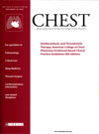
Recommendations of 8th ACCP (2008)
American College of Chest Physicians
Evidence-Based Clinical Practice Guidelines (8th Edition)
Chest 2008
http://www.chestjournal.org/content/133/6_suppl

Slide 59
Dalteparin – dosage
  Treatment of DVT and pulmonary embolism (acute phase)
  Administration by the subcutaneous route
  Single administration or two daily administrations
  Oral vitamin K antagonist treatment (warfarin/acenocoumarol) can begin immediately
  Combination therapy with oral anticoagulants must be continued until these reach a therapeutic level (normally 3 to 5 days)
  Outpatient treatment using the same dosage regimens is possible
Notes:
FOR SPEAKER USE ONLY. DO NOT COPY, DISTRIBUTE, OR DISSEMINATE.

Slide 60
Dalteparin – dosage
  Treatment of DVT and pulmonary embolism (acute phase)
  Administration once daily
    Dose: 200 IU/kg as a single administration (maximum 18,000 IU)
    Dose table for prefilled syringes:
    There is no need for monitoring of the anticoagulant effect
Weight (kg) | Dose | Single-dose prefilled syringe (25,000 IU/ml)
≤ 45 | 7500 IU | 0.3 ml
46 to 56 | 10,000 IU | 0.4 ml
57 to 68 | 12,500 IU | 0.5 ml
69 to 82 | 15,000 IU | 0.6 ml
≥ 83 | 18,000 IU | 0.7 ml
Notes:
FOR SPEAKER USE ONLY. DO NOT COPY, DISTRIBUTE, OR DISSEMINATE.

Slide 61
Dalteparin – dosage
  Treatment of DVT and pulmonary embolism (acute phase)
  Administration twice daily
    Dose: 100 IU/kg twice daily (maximum 18,000 IU)
    There is no need for monitoring of the anticoagulant effect (except in special populations – see earlier)
Notes:
FOR SPEAKER USE ONLY. DO NOT COPY, DISTRIBUTE, OR DISSEMINATE.

Slide 62
THANK YOU FOR GIVING US A THOUGHT

Slide 63
References
Agnelli G, Sonaglia F. 1998
Clagett et al, 1998;
Dahl et al 2000;
Sandler and Martin 1989
Prandoni et al 1997;
Bergqvist et al 1997
Geerts WH etal. Chest. 2004;126:338S-400S.
Hirsch DR et al. JAMA. 1995;274:335-337.
Cohen, et al. Lancet 2008;371:387-94.
Antithrombotic and Thrombolytic Therapy 8th Ed: ACCP Guidelines. Chest 2008; 133
Thromboembolic Risk Factors Consensus Group (1992)
American College of Chest Physicians Guidelines (2008)
Weitz 1997;
Quader et al 1998;
Sarret et al 1999;
Fareed et al 1999;

Slide 64
References
Warkentin 1995;
Fragmin US prescribing information, 2000;
Lovenox US prescribing information 2000
Circulation. 2004;110:874-879
Arch Intern Med. 2008;168(16):1805-1812
Levitan N et al, Medicine (Baltimore). 1999 Sep;78(5):285-91.
N Engl J Med 2003;349:146-53.

