Slide 1
HSCT PROTOCOL FOR M. E.
BY DR IHEANACHO O.E.

Slide 2
INTRODUCTION
Biodata
  Male, 15years, student.
Diagnosis
  SCA
Treatment
  HSCT
    HLA-matched sibling donor.
    RIC using Flu/Bu

Slide 3
PROTOCOL
Stem Cell Unit, Dept of Haematology, Blood Transfusion and Stem Cell Transplantation. Physician:Bazuaye G. N 05.07.2013
Patient: Matthew Ebenezer, DOB: 23.11.1997Diagnosis: Sickle Cell Anaemia Donor: Matthew Naomi (MSD), Genotype: AA
Conditioning: Flu 180 mg/m², Bu 16mg/kg, ATG (ATGAM) 1500mg total dose over 3days, CSA 5mg/kg/day. (analog EBMT 2005 Sykora und Sauer et al.) Weight. 48 kg, Height 175 cm, BSA 1.53 m²
 | Date | Conditioning | Doses | Route | Immunsuppr. 10mg/kg | Isolation | Heparin | CsA 200mg/d | MMF i.v. 1200 mg/^{m2} | Acyclor 1500 mg/^{m2} | Gut decontamination
 | Tue 16.07.2013 | Catheter
-7 | Wed 17.07.2013
-6 | Thu 18.07.2013 | Fludarabine | 40 mg/m² | IV. | ATGAM 500mg
-5 | Fri 19.07.2013 | Fludarabine Busulphan | 40 mg/m² 4mg/kg/d | IV PO | ATGAM 500mg
-4 | Sat 20.07.2013 | Fludarabine Busulphan | 40 mg/m² 4mg/kg/d | IV PO | ATGAM 500 mg
-3 | Sun 21.07.2013 | Fludarabine Busulphan | 40 mg/m² 4mg/kg/d | IV PO
-2 | Mon 22.07.2013 | Fludarabine Busulphan | 20 mg/m² 4mg/kg/d | IV PO
-1 | Tue 23.07.2013 | Rest day
0 | Wed 24.07.2013 | BMT
+1 | Thu 25.07.2013
+2 | Fri 26.07.2013
+3 | Sat 27.07.2013

Slide 4
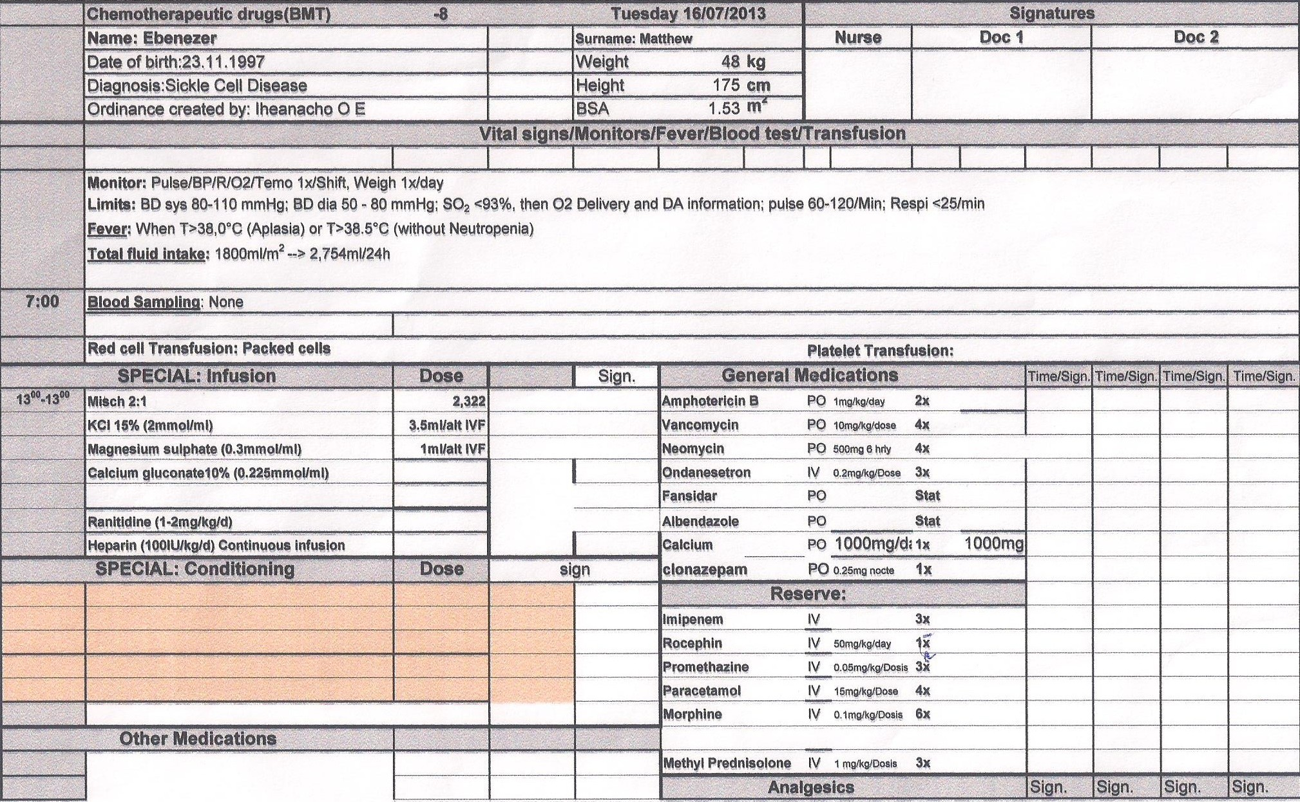
CHART FOR MONITORING PROCEDURES

Slide 5
Isolation & catheterization (from day-8)
  Isolation room for (reverse) barrier nursing.
  Catheterization for easy & steady IV access.
Adequate hydration (1800ml/m² )from day-8
VOD prophylaxis/ thromboprophylaxis
  Heparin (cont IVF) 100IU/day
  From day -7
Gut decontamination
  Oral neomycin, vancomycin, gentamycin, ampho B.

Slide 6
Conditioning regimen (RIC)
  IV Fludarabine 180mg/m² over 5days (-6 to -2)
  Busulfan PO 16mg/kg over 4days (-5 to -2)
  ATG 1500mg over 3 days(-6 to -4)
Day -1 is a rest day (chemo drug holiday).
Day 0: infusion of donor HSC (transplantation)

Slide 7
GVHD prophylaxis
  Ciclosporin A (PO) from day -3
  Mycophenolate mofetil 1200/m² from day0
Antimicrobial/ antihelminthic prophylaxis
  Viral (acyclovir)
  Fungal (fluconazole), Pneumocystis jiroveci (septrin)
  Protozoal (fansidar, paludrine)
  Helminths (albendazole)

Slide 8
Prophylaxis for some drug S/E
  Seizure (clonazepam)
Supplement
  KCl, Ca²⁺, MgSO₄
Blood product transfusion (no mismatch)
  O Rh pos/neg blood products.
  Leukodepleted, irradiated
  Red cells from AA (genotype) donor.

Slide 9
Conclusion
Protocol was adopted from EBMT 2005, Sykora et al.
  Individualized to fit our recipient & setting.
  Open to constructive criticisms/amendments.

Slide 10
THANK YOU

