Slide 1
HSCT IN ADULT LEUKEMIA
Dr Obieche J.C.

Slide 2
Factors to be considered before HSCT in Adults
Age
Performance status
Kinetics of disease proliferation
Cytogenetics
Donor type
Level of HLA matching

Slide 3
Acute myeloid leukemia
Indications for HSCT in Adult Leukaemia
  Remission induction
  Post remission therapy
  Depends on risk stratification and availability of sibling donor
    CR1
    CR2
    HDC- Unsatisfactory
    HSCT- KIT in CBF AML, FLT3-ITD mutation,
    MLL-PTD, High EVI expression
  Drawbacks-
    Age
    Absence of HLA matched sibling donor
    HSCT drug –related toxicities
    State of organ system

Slide 4
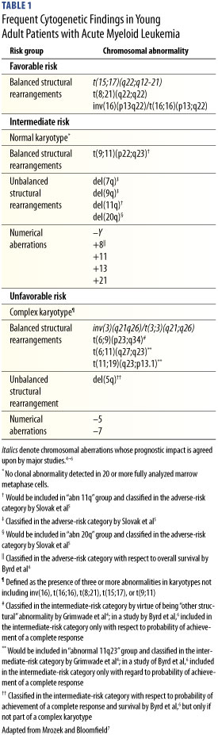
Adapted from Mrozek K et al; Hematology 2006

Slide 5
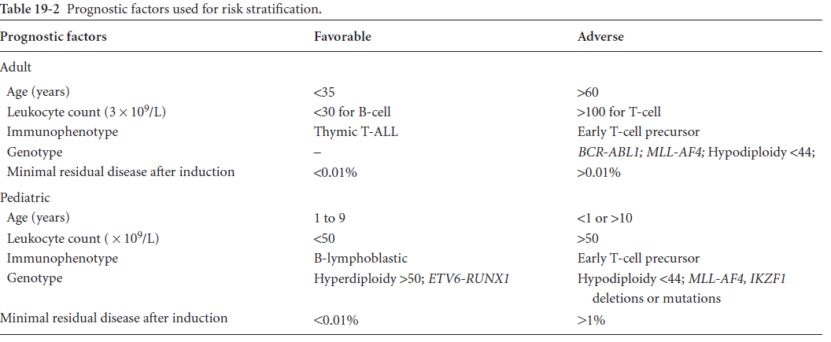
Acute lymphoblastic leukemia indication for HSCT- overview

Slide 6
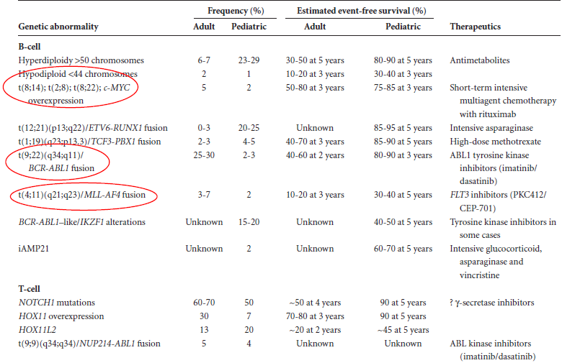

Slide 7
Acute lymphoid leukemia indication for HSCT
CR 1
  Poor risk cytogenetics
    t(9;22), t(4;11), t(11;19), t(9;11), t(1;19), t(8;14)
    Complex karyotype
  WBC >30,000/ml (B cell); >100,000/ml (T cell)
  >4wk to achieve CR
  Age >30 yrs
MRCUKALLXII-ECOG2993- 5 year OS 53 vs 45%

Slide 8
considerations
Clinical considerations
    Age
    WBC
Cytogenetics and Molecular genetics Considerations
    ETV6-RUNX1
    MLL rearrangement
    ABL-BCR
MRD Considerations
  Stratification after induction chemo
  Prediction of imminent relapse
  Predictor of outcome during 2nd induction & b/4 allo for relapse cases

Slide 9
HSCT in adult chronic myeloid leukaemia
Pre TKI era
Allo-SCT score sheet
  10 years OS rate –
    CP- 80%
    AP-40%
    BP-10%
TKI era
  CP-
    Primary therapy
      CCyR -80%
      Survival at 7+ years 90%
      Failure 20%

Slide 10
    Secondary therapy
      CCyR -50%
      Survival at 3years- 80%
  AP & BP
    Can achieve CCyR, but Poor PFS
    T3151 does not respond to the currently available TKI
    Who should be considered for allo-SCT?

Slide 11
Chronic Phase:
  Cases intolerable to all TKI
  Those that acquire T3151
  Wise to start donor search with commencement of salvage therapy
Advanced stage CML
  May respond to TKI, but not curative
  Consider allo-SCT early
Notes:
Predictor s of outcome I secondary TKI –early CCyR- good.
Failure of CCyR @3mo & mCyR @6mo are bad omen

Slide 12
TKI and transplant
  No deleterious effect with TKI pre transplant
  No evidence that resistant patient with Abl mutation has poorer outcome post-SCT

Slide 13
Chronic Myelogenous Leukemia
Factors | score
Disease phase
Chronic | 0
Accelerated phase | 1
Blast phase | 2
Age
<20 years | 0
20-40 | 1
>40 | 2
Stem cell source
Sibbling donor | 0
Unrelated donor | 1
Time from diagnosis to transplant
<12 mo | 0
>12mo | 1
Recipient-donor gender combination
Male into male | 0
Male into female | 0
Female into female | 0
Female into male | 1
Notes:
10 year os= 70% best score, 20 worst score

Slide 14
Chronic lymphocytic leukemia indication for allo-SCT
Poor risk CLL
  Primary resistance to purine analogue based therapy
  Relapse within 24 mo of therapy
  ZAP 70
  High CD 38 expression
  Mutation/ deletion of 17p14
  Richter’s transformation
  Relapse after autologous transplant

Slide 15
RIC and SCT in CLL
Conditioning Regimen should contain Fludara ± TBI
Outcome:
  NRM~20%, PFS~ 40%, OS ~60 at 5 years
Auto-SCT- lower RR, similar OS with Observation at 5 year
Cord blood vs unrelated donor transplant

Slide 16
Multiple myeloma
Place of HSCT!
Before the era of immunomodulators
  Autologous SCT as part of of frontline treatment:
    CR-22-44%, median time to progression 18-24mo, OS 4-6 years
    High dose Mephalan 200mg/m²
    Well tolerated- NRM~2%

Slide 17
```````````````````````````````````````````````````````````````````````````````````````````````````
Era of immunomodulators
    Linelidomide
    Thalidomide
    Bortezomib
  Currently used as frontline treatments
    Higher CR,
Current guideline
Autologous HSCT
  Newly diagnosed, <65 years & good performance status
  Patient with adverse prognostic factors
    High β₂ microglobulin
    Del 13
    Poor outcome following HSCT

Slide 18
Other issues
  Early transplantation vs delayed
    Improved PFS
    Similar OS
    Shorter period of chemo
    Improved QOL
  Planned Tandem transplantation
    Higher response rate
    Higher relapse free, event free and OS

Slide 19
Maintainance therapy after HSCT
  Linelidomide
  Less progression and death

Slide 20
Myelodysplastic syndrome
Traditional treatment- Not curative
Allo-SCT- only curative therapy
Auto-SCT- not advised
Key points to Note
  Results are better for early stage disease
  Outcome worse with MDS 2˚ to prior therapy
  Matched related and unrelated donor give similar outcome
  MAB and RIC give similar result.

Slide 21
Conclusion
With general improvement in economy and standard of living, it is expected that more people will live into old age in Nigeria.
It is also expected that increasing number of person will present with leukaemia in old age.
It therefore becomes wise that haematologist should plan for HSCT adult leukemia

Slide 22
    Thank you for your audience

