Slide 1
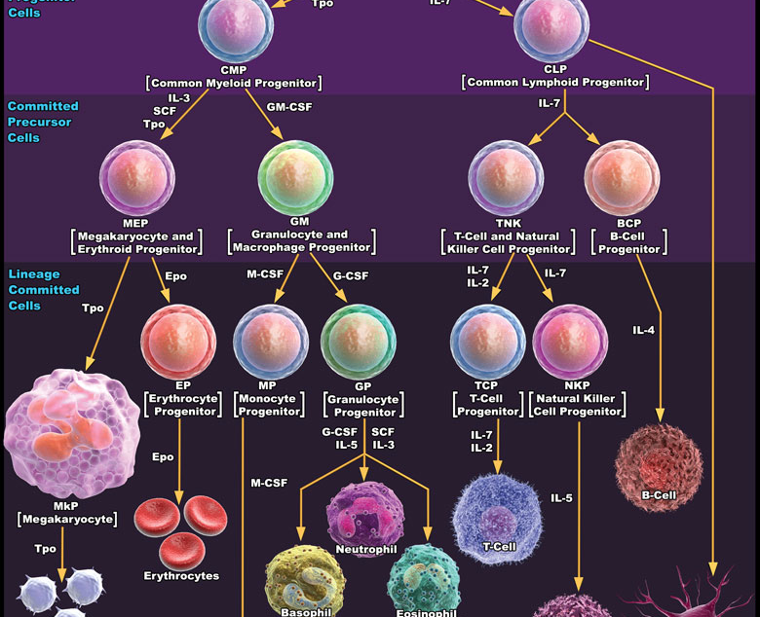
Haemostatic Challenges of Haemopoietic Stem Cell Transplantation
Omolade Awodu FMCPath
July 2013

Slide 2
Objectives
Factors contributing to haemostatic challenges in HSCT
Preventing haemostatic challenges
Tackling Haemostatic Challenges
2

Slide 3
My Talk
Overview of normal haemostasis
Types of haemostatic challenges
Preventing haemostatic inbalance?
Management of haemostatic challenges resulting from HSCT

Slide 4
HEMOSTASIS
Definition
Hemostasis: drives from the Greek meaning “The stoppage of blood flow”.
There are three haemostatic components:
The extra-vascular (The tissues surrounding blood vessels) involved in Hemostasis when local vessel is injured.
2- The vascular (The blood vessels) it depends on the size, amount, of smooth muscle within their walls and integrity of the endothelial cell lining.
3- The intra-vascular (The platelets and plasma proteins that circulate within the blood vessels).
Notes:
Comes to play in local blood vessel injury by swelling and trapping extravasated blood thereby providing a back pressure and reducing blood loss. The components are involved in coagulation( clot or thrombus formation) or fibrinolysis clot or thrombus dissolution

Slide 5
NORMAL HAEMOSTASIS:
It is a complex process depending on interaction between vessel wall, platelets and coagulation factors.

Slide 6
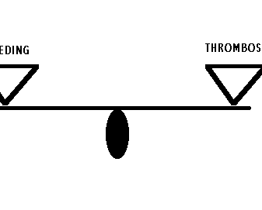
In physiological conditions, the process of thrombin formation and dissolution is maintained in a delicate balance
Notes:
Absence of this balance leads to bleeding ( from poor clot formation or excessive fibrinolysis or thrombosis ( from widespread thrombi formation and vasoocclusion of blood

Slide 7
Haemostasis:
BV Injury
Tissue Factor
Neural
Blood Vessel
Constriction
Platelet
Activation
Coagulation
Activation
Primary hemostatic plug
Reduced
Blood flow
Plt-Fusion
Thromibn,
Fibrin
Stable Hemostatic Plug

Slide 8
HEMOSTATIC SYSTEM
INTRINSIC
PATHWAY
EXTRINSIC
PATHWAY
COMMON PATHWAY
Thrombin
Fibrinogen
Fibrin
PLATELETS
CLOT
FIBRINOLYSIS
COLLAGEN
TISSUE FACTOR
VESSEL WALL

Slide 9
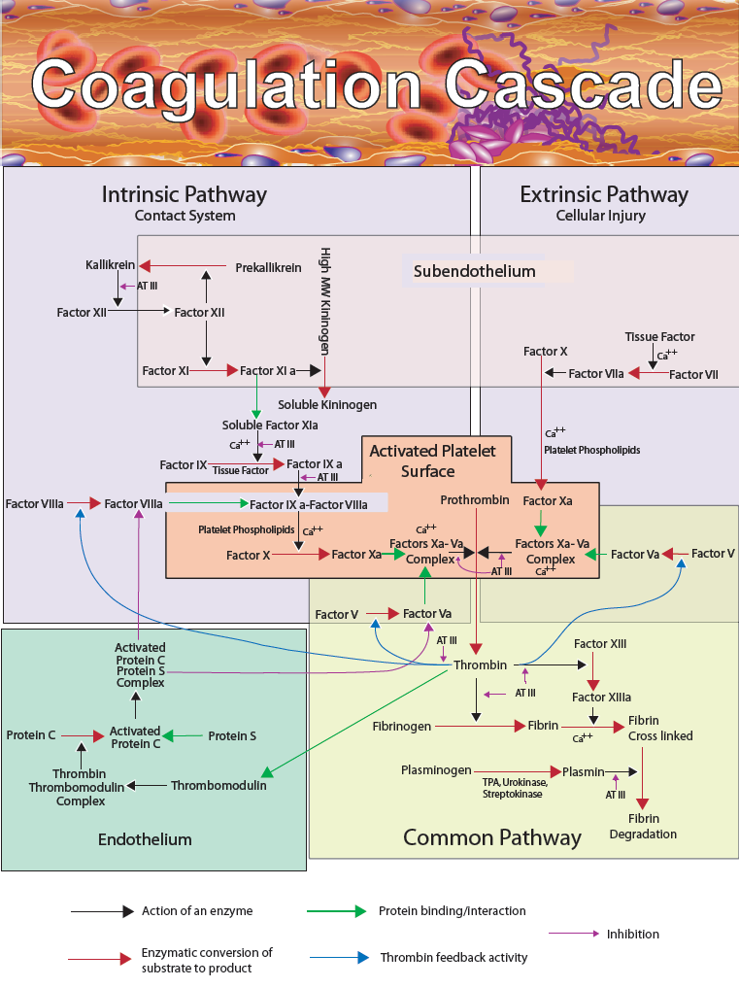

Slide 10
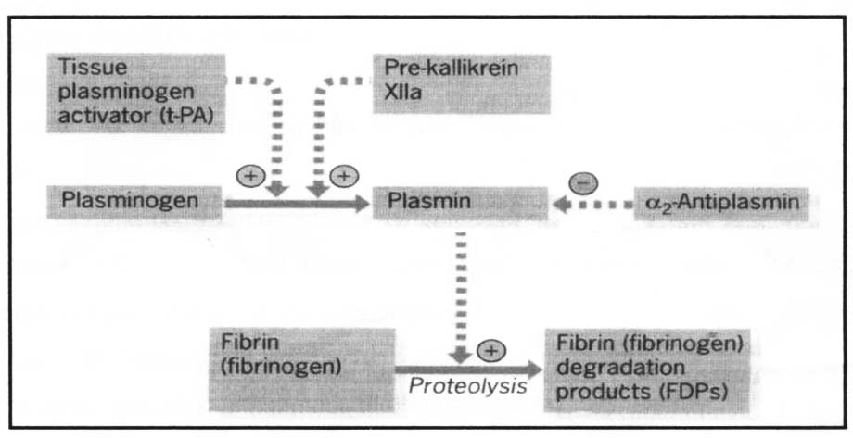
NORMAL HAEMOSTASIS:
FIBRINOLYSIS
It helps to restore vessel potency by dissolution of fibrin.
Normal plasma protein Plasminogen (formed in the liver) is converted by Plasminogen activators derived from plasma endothelial cells, platelets, leukocytes and urine into plasmin.

Slide 11
THE CENTRAL ROLE OF THROMBIN
FVII
FVIIa
FIX
thrombo-
modulin
TF
FXIa FXI
INITIATION PHASE
FIXa
PROPAGATION PHASE
Heparin-
cofactor II
FVIIIa FVIII
Elimination of thrombin
ENDOTHELIAL CELL
FX FXa
FVa FV
Anti-
thrombin
Prothrombin
Thrombin
Cross-linked fibrin
Fibrin Fibrinogen
FXIIIa FXIII
STABILIZATION PHASE

Slide 12
Activation of protein C
FVa
Activated
protein C
Protein S
FVIIIa
Thrombomodulin
Thrombomodulin
PAI-1 ↓
TAFI ↓
Protein C
EPCR
Thrombin
Endothelial cell

Slide 13
My Talk
Overview of normal haemostasis
Types of haemostatic challenges
Preventing haemostatic inbalance?
Management of haemostatic challenges resulting from HSCT

Slide 14
Haemostatic Challenges in HSCT

Slide 15
Definition
Haematopoietic stem cell transplantation (HSCT) is the transfer of multipotent haematopoietic stem cells from a healthy donor after myeloablative and non myeloablative conditioning
It is currently the only curative option for many malig- nant and non-malignant haematological diseases. Peripheral blood, bone marrow or umbilical cord are used as stem cell source.

Slide 16
Haemostatic challenges
Haemostatic complications
Acute
Thrombotic
Haemorhagic
Chronic
Thrombotic
Haemorhagic

Slide 17
Prothrombotic factors
Endothelial injury

Slide 18
Causes of endothelial injury in HSCT
Endothelial injury
Indwelling catheter
GVHD
radiotherapy
Chemotherapy
Infections

Slide 19
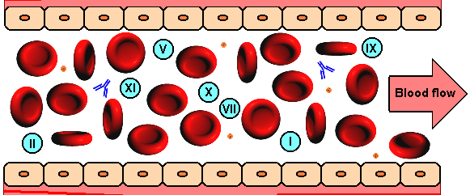
endothelium

Slide 20
In Case if there is an Endothelial Injury
(Bleeding must be prevented at site of injury)

Slide 21
Other prothrombotic factors

Slide 22
Sparse Data on alterations of procoagulant, anticoagulant and fibrinolytic factors in the early phase after HSCT

Slide 23
Decrease levels of natural anticoagulants:
  protein C
  antithrombin
  factors V and X and plasminogen
Gordon B, Haire W, Kessinger A et al. High frequen-cy of antithrombin 3 and protein C deficiency following autologous bone marrow transplantation for lymphoma. Bone Marrow Transplant 1991; 8: 497–502.
Collins P, Roderick A, O'Brien D et al. Factor VIIa and other haemostatic variables following bone marrow transplantation. Thromb Haemost 1994; 72: 28–32.

Slide 24
VTE, catheter-related thrombosis
Studies have shown that at about six months after transplantation, the incidence of symptomatic venous thromboembolism (VTE) is about 4.9%.
The majority of events were catheter- related VTEs (3.6%),
lower extremity DVT (0.7%)
pulmonary embolism (0.6%)
Gerber DE, Segal JB, Levy MY et al. The incidence of and risk factors for venous thromboembolism (VTE) and bleeding among 1514 patients under- going hematopoietic stem cell transplantation: im- plications for VTE prevention. Blood 2008; 112: 504–510.

Slide 25
Risk factors for VTE
The main risk factors predisposing to VTE were:
History of prior VTE (odds ratio 2.9)
Development of graft-versus-host disease (OR 2.4).
Allogeneic transplantation have higher rates of VTE compared to those treated with autologous transplantation

Slide 26
VTE
within the allogeneic population, development of GVHD is consistently associated with an increased risk of VTE.
Increase thrombin generation and decrease PAI-1 have been shown to correlate with onset of GVHD
Pinomaki A, Volin L, Joutsi-Korhonen L et al. Bone Marrow Transplant 2010; 45: 730–737.

Slide 27
Polymorphisms in coagulation proteins such as the factor V G1691A mutation (fac- tor V Leiden) or the prothrombin G20210A mutation are well-established risk factors for VTE in the general population.
Limited studies on their effects in HSCT patients

Slide 28
Treatment and prevention of VTE
Exact role of thromboprophylaxis in catheter related VTE not clear
A single arm trial with minidose warfarin (1 mg/d fixed dose if platelet count >50 x 10 ⁹/l has been reported to produce a comparatively low rate of VTE

Slide 29
VTE treatment in HSCT
Treatment of established VTE after HSCT is as for thromboembolic events outside the HSCT setting.
Special precaution must be taken because of the increased risk of bleeding resulting from thrombocytopenia and mucositis in the immediate post-transplant period, this may necesscitate dose reduction of the anti- coagulants

Slide 30
Patients must be monitored intensively.
Haemostatic support with platelet concentrates must be readily available

Slide 31
Pathogenesis of VOD
Microoclusion
Cell oedema
Toxic injury of sinusoidal endothelial cells & hepatoscyes
Progressive liver damage
Multiorgan failure

Slide 32
Diagnostic Criteria for VOD
Seattle
Baltimore
At least two factors must be present within 20 days after transplantation) ● Hyperbilirubinaemia (total serum bilirubin >2 mg/dl)
● Hepatomegaly or upper right quadrant pain of liver origin
● Sudden weight gain (>2% of baseline body weight)
McDonald GB, Sharma P, Matthews DE et al .Hepatology 1984
Hyperbilirubinaemia and two additional factors must be present within 100 days of transplantation)
● hyperbilirubinemia (total serum bilirubin >2 mg/dl)
● Hepatomegaly
● Right upper quadrant pain of liver origin
● Sudden weight gain (>5% of baseline body weight)
Jones RJ, Lee KS, Beschorner WE et al Transplantation 1987

Slide 33
Diagnosis confirmed by histology
Microthromboses and fibrin deposition in hepatic central venules
Hepatic congestion, and signs of portal hypertension in the absence of in- flammatory infiltrates.
Reversal of the blood flow in hepatic veins documented by duplex ultrasound analysis also supports the diagnosis.

Slide 34
Plasmatic markers of coagulation are all up regulated in VOD
Thrombomodulin, P- and E-selectins,
Tissue factor pathway inhibitor (TFPI),
Soluble tissue factor,
Plasminogen activator inhibitor (PAI-1) have all been shown to be up-regulated during VOD.
An elevated PAI-1 level has also been advocated as a diagnostic and prognostic marker for VOD

Slide 35
The frequency of VOD is in the range of 10% after allogeneic stem cell transplant

Slide 36
Risk factors for VOD
Pre-existing hepatic damage
● previous high-dose chemotherapy
● Previous abdominal irradiation
● Donor-recipient HLA disparity and
● Female gender.
Salat C, Holler E, Kolb HJ et al. Blood 1997

Slide 37
Treatment of VOD
Mild VOD may resolve spontaneously
the prognosis of patients with advanced stages is grim.
Presently no treatment with proven efficacy for VOD
Treatment is mainly supportive

Slide 38
Defibrotide, a polydisperse mixture of single- stranded oligonucleotides with antithrombotic and fibrinolytic effects on the micro- vascular endothelium is increasingly being used to treat VOD.

Slide 39
It binds to microvascular endothelium via adenosine receptors, modulates platelet activity by enhancing levels of endogenous prostaglandins and thrombomodulin, and promotes fibrinolysis via up- regulation of TFPI and tissue plasminogen activator (t-PA).

Slide 40
In clinical phase II studies, defibrotide showed remission rates in patients with VOD in the range of 40%. Importantly, responses occurred in the absence of severe hemorrhage or other toxicity. Large phase III trials are currently being conducted.
Richardson PG, Murakami C, Jin Z et al. Blood 2002

Slide 41
Transplant-associated thrombotic microangiopathy
(TA-TAM , TAM)
It occurs in 5–10% of patients treated with allogeneic transplantation
Mortality rate in excess of 50%.

Slide 42
Thrombocytopenia, schistocytes, increase LDH, bilirubin and reticulocytes as signs of hemolysis, kidney failure, and neurologic abnormalities which are features of TTP are also seen in TA-TAM.

Slide 43
TAM mainly results from endothelial injury and not deficiency of ADAMTS-13
TAM usually develops within the first 100 days after transplantation.

Slide 44
Risk factors for the development of TAM
● Fungal or viral infection
● Presence of GvHD
● Female sex
● Unrelated or HLA-mismatched donor grafts,
● the use of calcineurin inhibitors such as cyclosporine

Slide 45
In Case if there is an Endothelial Injury
(Bleeding must be prevented at site of injury)

Slide 46
Concensus Criteria for diagnosis of TA-TAM
Increased percentage of schistocytes in peripheral blood smear (> 4%)
● De novo, prolonged or progressive thrombocytopenia
(< 50 G/l or >50% decrease from previous counts)
● Sudden and persistent increase in lactate dehydrogenase
● Decrease in haemoglobin concentration or increased red blood cell requirements
● Decrease in serum haptoglobin concentration
International Working Group
Ruutu T, Barosi G, Benjamin RJ et al. Haematologica 2007

Slide 47
Diagnostic criteria
RBC fragmentation and ≥ 2 schistocytes per high-power field on peripheral smear
● concurrent increased serum lactate dehydrogenase above institutional baseline
● concurrent renal* and/or neurologic dysfunction without other explanations
● negative direct and indirect Coombs test results
BMT CTN Toxicity Committee
Ho VT, Cutler C, Carter S et al. Biol Blood Marrow Transplant 2005;

Slide 48
Treatment of TA-TAM
No standard treatment for TAM is known.
Plasma exchange is not generally recommended in the treatment of TAM, anecdotal evidence suggests that it may benefit a subgroup of patients.
The demonstration of antibodies against complement factor H in patients with TAM responsive to plasma exchange might pave the way for a more differentiated use of this treatment option in selected patients in the future.
Laskin BL, Goebel J, Davies SM, Jodele S. Blood 2011

Slide 49
Treatment of TA-TAM
Response to the B-cell depleting anti-CD20 antibody rituximab have been reported in some small case series.
Modification of the immunosuppressive regimen is now frequently proposed as the first treatment step: as inhibitors of both calcineurin have been implicated in the development of TAM
Trials with eculizumab – a monoclonal antibody against the complement protein C5 producing excellent results in atypical hemolytic uremic syndrome – are ongoing.
Au WY, Ma ES, Lee TL et al. Br J Hae- matol 2007
Nurnberger J, Philipp T, Witzke O et al. N Engl J Med 2009

Slide 50
Bleeding complications
Acute bleeding is associated with increased morbidity and mortality, and is a frequent complication after both allogeneic and autologous HSCT
The risk of clinically relevant bleeding is at least 10-fold higher in a transplant population compared to general medical oncology patients under- going chemotherapy
Holler E, Kolb HJ, Greinix H et al. Bone Marrow Transplant 2009

Slide 51
Incidence
In the so far largest cohort study published by Gerber and co-workers 230 of 1514 patients (15.4%) undergoing HSCT experienced clinically significant bleeding complications.
The majority of the bleeding events (39%) occurred in the gastrointestinal tract, followed by genitourinary (23%) and pulmonary bleedings (17%), and haemorrhage of the central nervous system (10%).
Twenty –four % of these events were fatal, 3.6% of the HSCT patients in the cohort died from bleeding. Other authors reported comparable or slightly lower mortality rates from bleeding complications

Slide 52
Risk factors
The strongest predictor of bleeding was the initiation of anticoagulation during the first half year following HSCT (OR 3.1).
Other strong risk factors included the development of veno-occlusive disease (VOD; OR 2.2) and GvHD (OR 2.4) .
Two major peaks of bleeding incidences were identified: in patients without coexisting GvHD at around 10 days after HSCT during the thrombocyte nadir
● Around one month after HSCT in patients developing GvHD after engraftment.

Slide 53
Risk factors
Prolonged thrombocytopaenia
ATG
Notes:
ATG- activation of coagulation cascade from cytokiene releas

Slide 54
HSCT-specific haemorrhagic complications
Diffuse alveolar haemorrhage
Pathogenesisis of DAH is poorly understood
It is associated with:
● Older age,
● Allogeneic donor source,
● Myeloablative conditioning regimen
● Acute GvHD.
Notes:
Cytokine release following damage to alveolar capillary endothelium is speculated to cause DAH

Slide 55
Treatment
High dose corticosteriod ( exact dose and duration unclear)
Mortality is high
Steriod plus tranexamic acid promises a better outcome being studied

Slide 56
Haemorhagic Cystitis
Haemorrhagic cystitis (HC) accompanied by microscopic or gross haematuria with clots that can lead to urinary tract obstruction occurs in 12–25% of HSCT patients
HC is often associated with painful dysuria and resolves spontaneously in most cases. Nevertheless, HC has the potential to cause significant morbidity and mortality due to bladder tamponade causing renal failure
Early HC (day 1–3 after HSCT) is usually related to the toxic effects of the conditioning regimen, particularly the use of high dose cyclophosphamide.

Slide 57
Haemorhagic cystitis
A second peak in HC – which is unrelated to conditioning regimen toxicity occurs one to two months after HSCT and is associated with
  – allogeneic grafts,
  – advanced age,
  – GvHD,
  – thromb ocytopenia

Slide 58
Haemorhagic cystitis
Coagulopathy
viral infection

Slide 59
Treatment
Treatment of HC is mainly supportive as the condition is self-limiting in most cases
Neither antiviral therapy nor haemostatic therapy with rFVIIa have proved to alleviate patients’ symptoms successfully.

Slide 60
Treatment
Thrombocytopaenia very important cause of bleeding
Platelet transfusion ether to prevent or treat acitve bleeding, serious bleeding often associated with platelet count of 10,000/ul , fatal bleeding at 5000/ul
NIH has recommended a lowering of the threshold of 20000/ul
Infections and mucositis in SCT recipients may warrant transfusion at 20,000 or higher

Slide 61
treatment
In active bleeding consider transfusion if platelet count less than 75000/ul
Dose response effect f transfusion: transfusion of 1 x 10¹¹ increases platelet count by approximately 10,000/ul in a 70 kg patient
One platelet concentrate is usually given per 10 kg of body weight it increases the platelet count by about 40,000/ul

Slide 62
Conclusion

Slide 63
Late Complications
Incidence of bleeding and thrombotic complication highest in the early phase
Bleeding complications mainly associated with use of anticoagulant to treat thrombotic complication

Slide 64
Arterial Thrombosis and premature atherosclerosis
Commoner in allogeneic
Cumulative risk of 11 % at so years and 6% at 15 years

Slide 65
Mehanism
It has been suggested that these complications are caused by an endothelial form of GvHD .
in favour of the hypothesis It has been demonstrated that GvHD leads to changes in a variety of endothelial markers such as thrombomodulin, plasminogen activator inhibitor, von Willebrand factor, endothelin, VEGF, VCAM and ICAM)

Slide 66
Haemostatic challenges in HSCT are characterized by both bleeding and thombotic complications. These have contributed to the morbidity and mortality recorded in HSCT patients. Bleeding results mainly from thrombocytopenia occasioned by myelosupression while thrombotic complications are mainly due to endothelial injury. The exact trigger for platelet transfusion is still a subject of debate. Local cut offs based on threats of bleeding may be the preferred option.
Thromboprophylaxis increases the risk of bleeding in HSCT patients. Established VTE should be treated as de-novo VTE. As we progress in HSCT in Nigeria, there is a need to set up local guidelines for bleeding and thrombotic risk assessments pre-transplant to reduce bleeding and thrombosis related morbidity and mortality post HSCT

Slide 67
Thank you

