Slide 1
Prevention of infections in a stem cell transplantation unit
By
D.N. Onunu
Department of Nursing Services
University of Benin Teaching Hospital Benin City, Nigeria

Slide 2


Slide 3
Definitions
Infections are caused by micro-organisms such as:
  Viruses
  Prions
  Bacteria
  Viroids
  larger organisms like macro-parasites and fungi

Slide 4
Infections
Infection is the
  invasion of a host bodily tissues by disease causing organisms
  their multiplication
  and the reaction of the host tissues to these organisms and the toxins they produce

Slide 5
Sources of infection for the transplant patient
Patient physiological bacteria
Personnel
Central venous catheter (CVC)
Infusions
Medications
Water
Air
Visitors

Slide 6
Principles of infection control
Preventive isolation
  this has been used to reduce risk of infection for the neutropenic patient
Use of protective clothing
  gowns, gloves and face masks

Slide 7
Prevention 1
The patient
Health care personnel/staffs
Visitors or relations

Slide 8
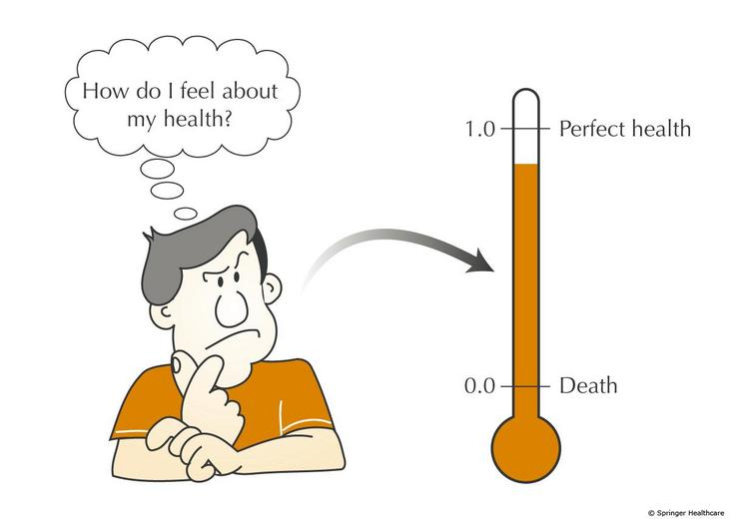

Slide 9
Prevention ;PATIENT
Patient is taught and made to comply to hand hygiene
  e.g washing hand with soap and water after visiting the toilet
Use of octenisept disinfectant to disinfect the rectum following defecation
Use of lifoscrub for his shower-contains chlorhexidine
Patient is encouraged to take water with gas. As water without gas can have bacteria
Patient hygiene – daily bath or shower should be encouraged.
Mouth care
  regular assessment of the mouth and mouth care is essential

Slide 10
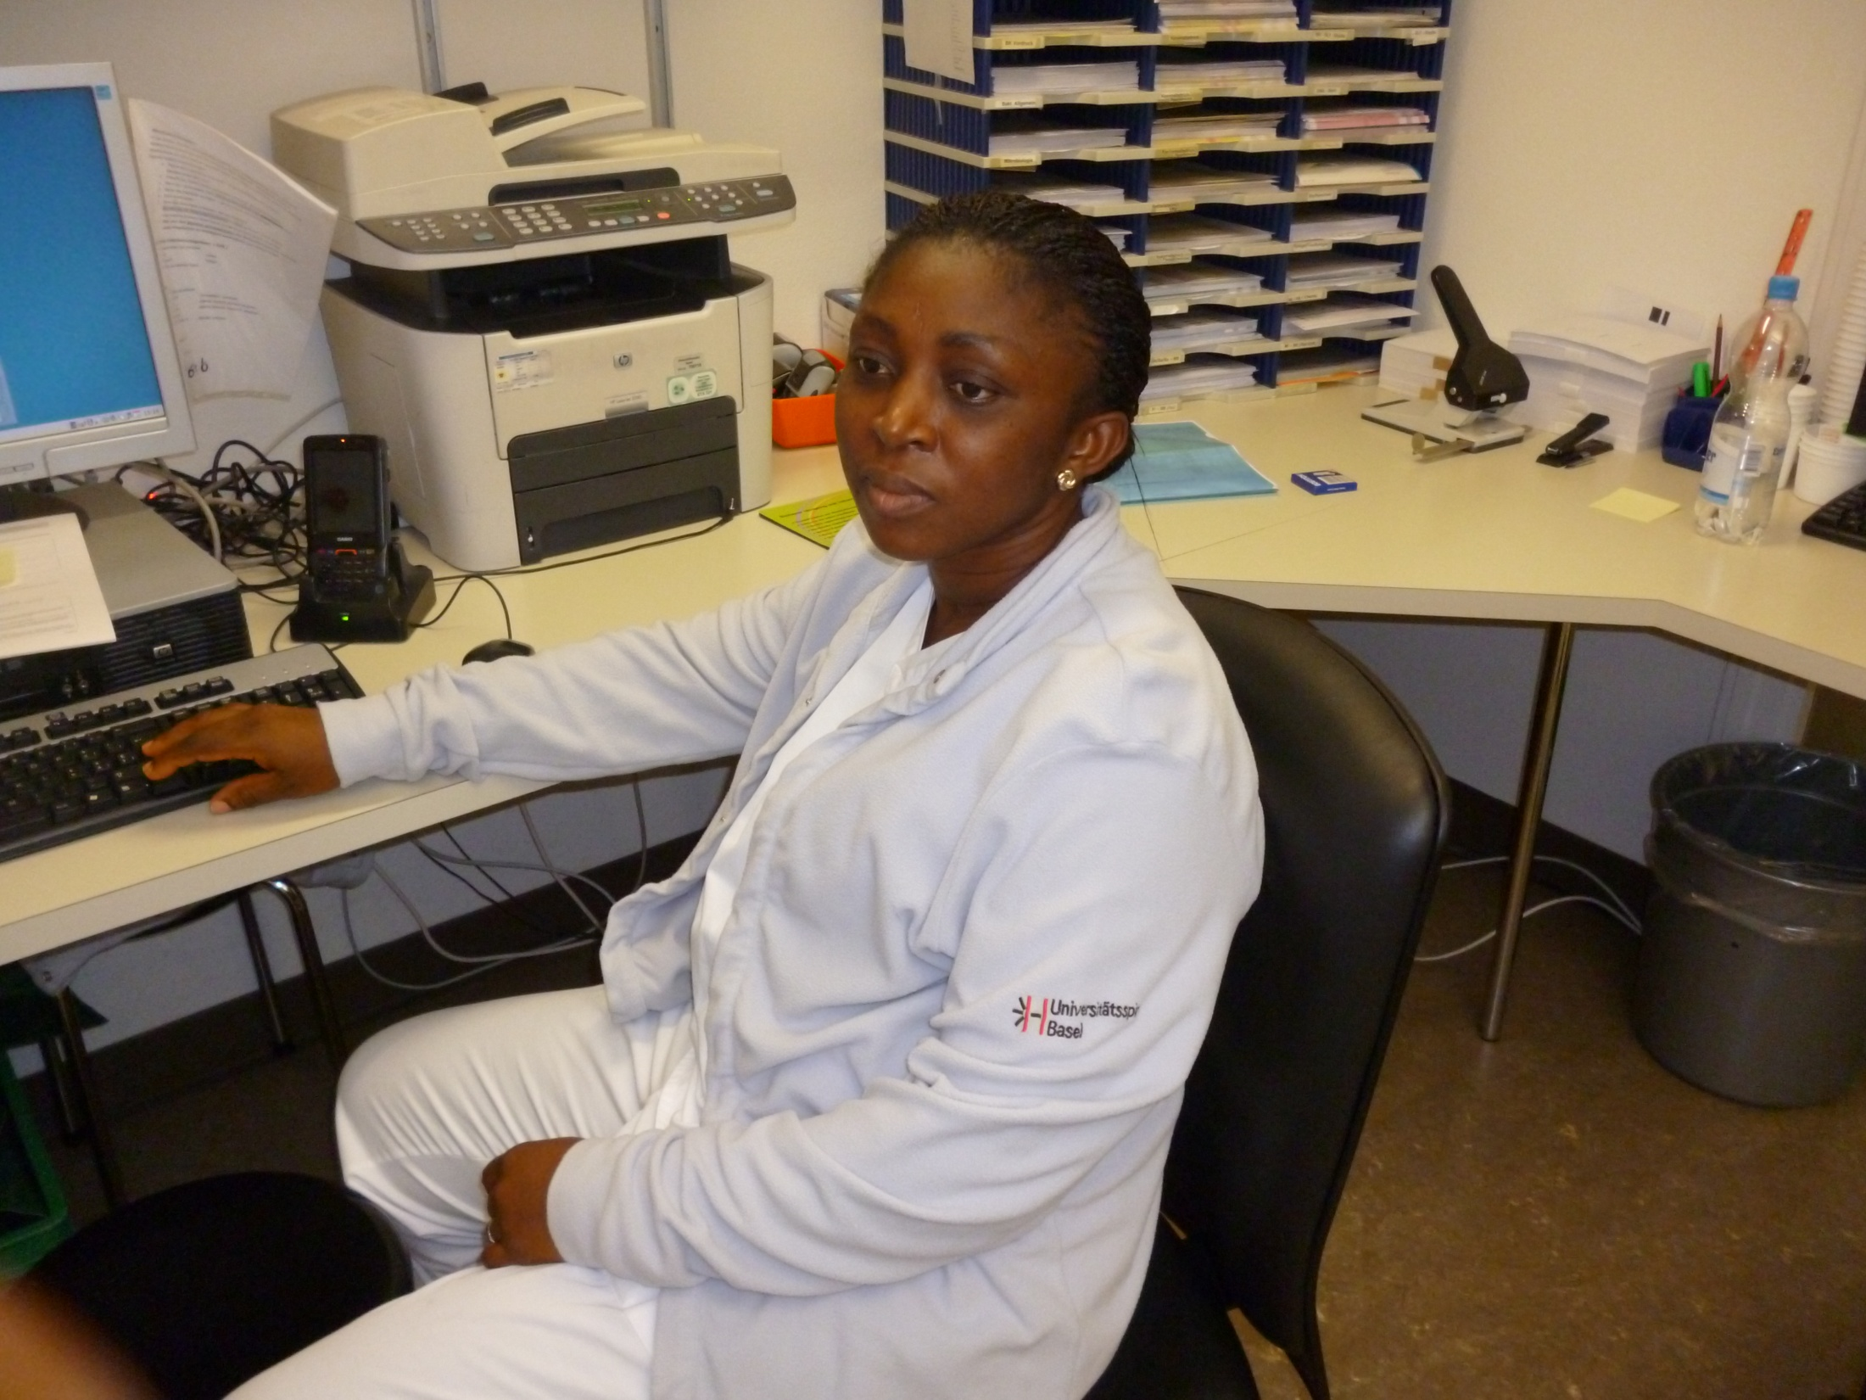

Slide 11
Prevention; HEALTH CARE PERSONNEL
Knowledge and compliance to CDC guidelines by health care personnel
Hand washing with liquid soap is suitable for removal of transient organisms.
Hand washing is the single most important procedure for preventing infection
Drying is an essential part of the hand hygiene process
Rings and wristwatches must be removed.
Bactericidal alcoholic hand-rub is a quick effective means of cleansing hands
  This can be done when hands are clean

Slide 12
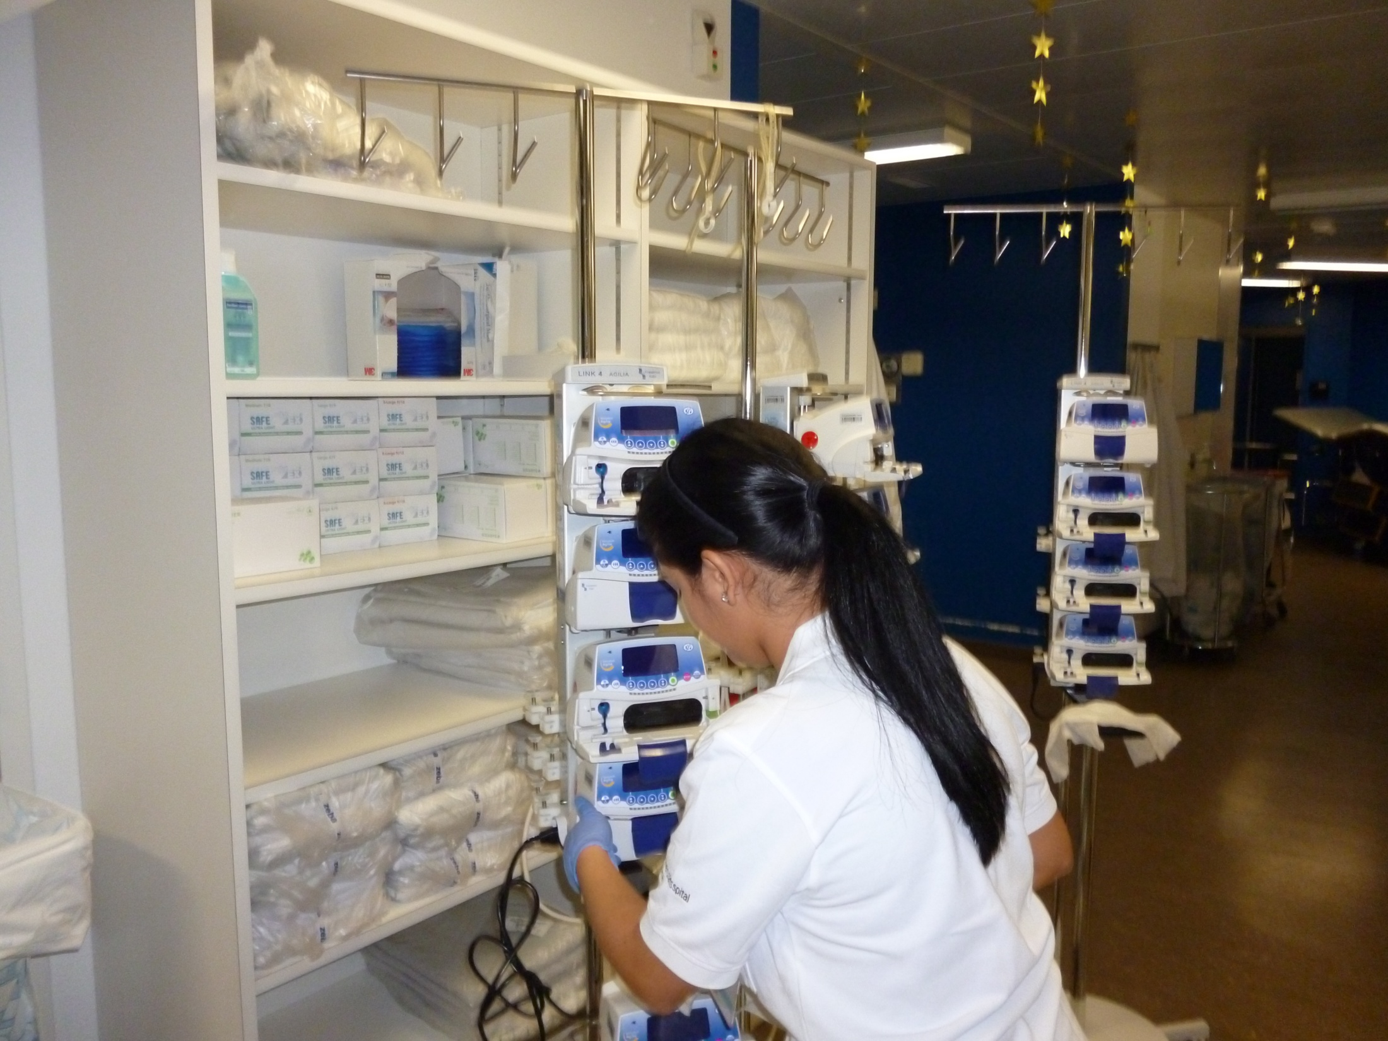

Slide 13
Prevention 2
Proper use of protective clothings - proper use of gowns, facemask gloves before entering the isolation rooms
Application of bactericidal lotions in the sinks, toilets and drains in the bathroom
Rorm should be cultured twice a year – or as the case may be depending on centre.
Environmental cleanliness – surfaces, equipments, toys, bed and patients toilet should be cleaned daily.
Maintainance of strict aseptic techniques during all tasks

Slide 14
Prevention 3
Clean food – under cooked fish and meat are potential risk for infection, so food must be properly cooked for immunosuppressed patients
Bed pans and urinals should be washed and disinfected before use
All shared equipments must be heat treated between use.
Reliable hospital laundary – used linen must be washed and thermally disinfected to eliminate micro-organisms
Clean linen should be stored in a safe clean manner
Regular observations – vital signs should

Slide 15
Prevention 4
Regular observations
  vital signs should be monitored regularly as pyrexia is a sign of infection and patient must be screened immediately.
Fit and healthy staffs
  staffs should be free from infection.
    Should stay away from the centre when they have catarrh, cough,(common cold).Have adequate vaccination.

Slide 16
Prevention 5
Restrict potted plants and flowers in the rooms as they are reservoir to potential pathogens
Patient education
  important because it enhances patients compliance to prevention of infection.

Slide 17
Prevention; Visitors/Relations 1
Health educate visitors on the need to keep away from the centre when they have common cold or contagious disease

Slide 18
Prevention; Visitors/Relations 2
Rules to imbibe when visiting;
  Do not come in with foods or drinks.
  Carry out proper hand washing and sanitizing.
  Wear gowns, facemasks and gloves prior to entering the isolation rooms.
  Not to remove face mask while in the isolation room.
  They should not eat or drink in the room.
  They should not use patients toilet.

Slide 19
Discharge planning
Discharge planning
  proper health education should be given to significant family members who will be providing help and support to the immuno-compromised patient.

Slide 20
Improving Infection Control
Research
  development of scientific knowledge based nursing practice – to identify new and effective strategies to prevent infection is essential.
Standards
  can be used as the basis for measuring quality care provided to patients.
Audit
  this is a systematic, critical and continuing analysis of quality of care and use of resources to identify where improvements can be made – such as mouth care, care of CVC, compliance to hand washing.

Slide 21

Thank you for listening

