Slide 1
HAEMATOPOIETIC STEM CELL TRANSPLANTATION FOR NON-MALIGNANT DISEASES IN CHILDREN
Dr. Y. T. Israel-Aina
Paediatrician,
University of Benin Teaching Hospital,
Benin City.
Benin Blood and Marrow Transplant Workshop,
University of Benin Teaching Hospital, Benin City.
July 15 – 27, 2013.

Slide 2
Objectives
Give an overview of non-malignant diseases (NMDs)
Highlight challenges of haematopoietic stem cell transplantation (HSCT) in NMDs in children
Discuss the interplay of these challenges using sickle cell anaemia (SCA) as a prototype.

Slide 3
Non-malignant conditions (NMDs)
Inherited Marrow Failure Syndromes
Fanconi Anaemia
Diamond-Blackfan Anaemia
Schwachman-Diamond Syndrome
Dyskeratosis Congenita
Severe Congenital Neutropaenia
Acquired Marrow Failure Syndromes
Severe aplastic Anaemia
Haemoglobinopathies
Sickle Cell Anaemia
Beta-Thalassemia Major

Slide 4
Non-malignant conditions contd.
Primary Immunodeficiency Disorders
Severe Combined Immunodeficiency
Chronic Granulomatous Disorder
Wiskott-Aldrich Syndrome
Leukocyte Adhesion Deficiency
Immunodysregulatory Disorders
Hemophagocytic Lymphohistiocytosis
X-linked Lymphoproliferative Disorder

Slide 5
Non-malignant conditions contd.
Inborn Errors of Metabolism
Gauchers disease
Leukodystrophies – Krabbe, ALD
Mucopolysaccharidoses – Hurler’s syndrome
Osteopetrosis
Autoimmune disorders
- Juvenile rheumatoid arthritis
- Systemic lupus erythematosis
- Rheumatoid arthritis

Slide 6
Problems in NMDs
Defective immune system.
Missing enzymes.
Quantitative and qualitative deficiencies in blood cells.
Thus
Great challenge with survival of children
with these conditions!

Slide 7
Auto- or allogeneic transplantation
Autologous transplantation – used in some autoimmune diseases
Problems- recurrence of diseases
Allogeneic transplant is widely acceptable practice

Slide 8
Why Allo-transplantation in NMDs
Replace defective immune system.
Replaces missing enzymes.
Improves quantitative deficiencies in blood cells.
Improves qualitative defects in blood cells.

Slide 9
HSCT for NMDs in Children
HSCT for NMDs should be performed when a recipient is at a good functional baseline.
In anticipation of the inevitable organ damage expected overtime- thus age consideration.
Challenge
Variability in the eventual degree of morbidity, time of onset and severity of organ involvement pose a unique problem in defining both eligibility and ideal timing for HSCT.

Slide 10
Issues with transplant of NMDs
Decision to transplant can be challenging.
- Disease / Condition.
- Long term management of condition /
timing of transplant.
- Parents.
- Indications for transplant.
- Complications of transplant.
- Conditioning regimen.
- Source of graft.

Slide 11
Issues with transplant of NMDs contd.
Myeloablative – Better Engraftment?
More Toxicity (acute and long-term)
Conditioning
regimen
Reduced Intensity – Mixed chimerism expected. Less Toxicity. More risk of graft failure.
    ??No conditioning

Slide 12
Conditioning regimen for NMDs
Myeloablative regimen
  Busulfan (14-16 mg/kg)
  Cyclophosphamide 200 mg/kg
Radiation based
    TBI 750 cGy
    - Serotherapy
    ATG
    CAMPATH-1H

Slide 13
Conditioning regimen contd.
Drugs
Fludarabine 160-180mg/sq.m TD
Targeted Busulfan (lower doses for RTC 45-65mg/L/hr)
Serotherapy CAMPATH 1H 0.6-1mg/kg or ATG 10mg/kg TD
Sometimes, cyclophosphamide is added for refractory cytopaenia
Monitor Busulfan levels (AUCs : Area under the curve)

Slide 14
Day | Dat | Con. | Dose | CAM IH | CSA 3mg/kg/d | Hep | MMF 1200mg/m | Acy. | Mdd | Pro.
-10 |  |  |  |  |  |  |  |  |  | DFC
-9 |  |  |  |  |  |  |  |  | *
-8 |  | FLU | 30 | * |  | * |  |  | ,,
-7 |  | ,, | 30 | ,, |  | ,, |  |  | ,,
-6 |  | ,, | 30 | ,, |  | ,, |  |  | ,,
-5 |  | F+BU | 30+1.6 |  |  | ,, |  |  | ,,
-4 |  | ,, | ,, |  |  | ,, |  |  | ,,
-3 |  | ,, | ,, |  | * | - |  |  | ,,
-2 |  | BU | 1.6 |  | ,, | - |  |  | ,,
-1 |  | Rest |  |  | ,, | - |  |  | ,, | Rest
0 |  | BMT | - |  | ,, | ,, | * |  | ,, | BMT
+1 |  |  |  |  | ,, | ,, |  | * | ,,
+2 |  |  |  |  | ,, | ,, |  | ,, | ,,
+3 |  |  |  |  | ,, | ,, |  | ,, | ,,
+4 |  |  |  |  | ,, | ,, |  | ,, | ,,
+5 |  |  |  |  | ,, | ,, |  | ,, | ,,
+6 |  |  |  |  | ,, | ,, |  | ,, | ,,

Slide 15
Issues with transplant of NMDs contd.
Bone Marrow – Better engraftment, potential
problem finding donor
Source of graft
Umbilical Cord – Increased HLA
mismatch acceptable; increased graft rejection, delayed immune reconstitution
Peripheral Blood – Better engraftment, increased chronic GVHD

Slide 16
Issues with transplant of NMDs contd.
Donor source
Matched sibling donor MSD (70-90% survival)
Matched unrelated donor MUD (36-65% survival)
Matched or minimally mismatched single and double cord transplantations with appropriate cell dose
Haploidentical donor

Slide 17
Issues with transplant of NMDs contd.
Chimerism (amount of donor cells that engraft) is affected by
-The conditioning regimen
-The graft source.
-Cell dose (nucleated cell, CD34)
-The disease being transplanted
Stable mixed chimerism between 10-20% shows clinical improvement

Slide 18
Issues with transplant of NMDs contd.
Unstable long term engraftment /
graft failure
- 114/541 (21%) of non-malignant transplants (benign hematologic diseases
and immune deficiencies) had primary or secondary graft failure.
43/114 (38%) went on to second transplant. (King Faisal Specialist Hospital, Saudi Arabia)

Slide 19
Issues with transplant of NMDs contd.
Graft versus host disease (GVHD)
- No benefit in transplant for NMDs
- Increase morbidity and mortality after
HSCT
- Reduces quality of life after transplant

Slide 20
Primary immunodeficiencies
SCID- Heterogenous genetic disorder in T- lymphocyte differentiation
Combined T- and B- cell deficiency, 1 in 75,000 live births.
Early onset of symptoms, within first 6 months.
Prone to bacteria, viral, fungal, protozoan and opportunistic infections.

Slide 21
Severe combined immunodeficiency
SCID is a paediatric emergency
Without treatment, most infants die within the first year of life.
HSCT offers the cure for this condition
Divided into SCID and Non- SCID disorders

Slide 22
Severe combined immunodeficiency
Transplant mainly from HLA identical donor or T-cell depleted haploidentical BM / UCB.
Overall Survival is 60-70% compared to ≈80% from HLA compatible donors.
Greatest challenge is the decision to give pre-transplant chemotherapy or not.
Duke experience- no conditioning, but patients require multiple transplants and administration of IVIG due to lack of B-cell function.

Slide 23
Severe combined immunodeficiency
Centres that offer conditioning before transplant found complete donor engraftment, no need for IVIG and rate of multiple transplants is lower.
Other factors that affect outcome of transplant-
- age (<6months- best outcome)
- presence of opportunistic infections
- GVHD (maternally derived T
lymphocytes)
- Type of donor

Slide 24
Inherited bone marrow failure syndromes
Fanconi anaemia FA- congenital anomalies
-progressive bone marrow failure
-chromosome breakage
-cancer susceptibility (AML,
squamous cell carcinomas of the
head and neck and UG tract)
FA cells are hypersensitive to DNA cross linking agents.
Cy, Bu or irradiation increases breaks and tissue damage

Slide 25
Inherited bone marrow failure syndromes (FA)
Conditioning with low dose CY and total lymphoid irradiation- 85% 5-year survival. Newer regimen Flu / low dose Cy
MSD > MUD
Good prognosis
Younger patient / early transplantation
Limited malformations
No previous Rx with androgens
Risk of cancer in long term survivors

Slide 26
Other congenital cytopaenias
DKC, Shwachman-Diamond synd., Diamond-Blackman synd., Kostmann synd.
MSD allo-HSCT preferred in steroid resistant DBS and KS refractory to G-CSF or with acute leukaemia. OS for DBS 87.5%
Results for MUD in DBS (64%).

Slide 27
Sickle Cell Anaemia- a prototype
Inherited structural haemoglobinopathy.
The sickle haemoglobin (HbS) is a mutant haemoglobin
- single base substitution of thymine for adenine at the sixth codon of the gene encoding for the β chain.
- change encodes valine instead of glutamine at the sixth position on the β-globin chain.

Slide 28
Burden of Sickle Cell Anaemia
Sickle cell anaemia (SCA): homozygous for the sickle haemoglobin (Hb SS).
200,000 - 230,000 children are born with SCA in Africa every year.
Nigeria has been described as the country with the largest number of people with SCA!

Slide 29
Burden of SCA contd.
In Nigeria, the prevalence of SCA was 2% in 2006 (2 out of every 100 children born in Nigeria).
150,000 children are born yearly with SCA in Nigeria.
5% of U-5 mortality are attributed to SCA and more than 9% in west Africa, some countries are up to 16%

Slide 30
Burden of SCA contd.
Mortality increases with age
Average life expectancy for patients with SCD
-male – 42yrs
-female - 48 years
Acute and chronic complications of SCA

Slide 31
Severe complications of SCA
CNS involvement defined by overt stroke or high transcranial doppler velocities is a definitive indicator of continued risk for recurrent CNS events.
The incidence of overt stroke in SCD is 9% by 14 years of age.
Another 18% develop MRI changes consistent with silent cerebral infarcts by this age
27% rate of neurologic complications before adolescence.
Up to 20% of children with previous strokes and cerebral vasculopathy can experience second strokes within 5 years

Slide 32
Severe complications of SCA contd.
Cardiopulmonary events, acute chest syndrome and pulmonary hypertension account for > 50% mortality in young adults.
Tricuspid regurgitation was noted in more than 20% of children at mean age of 6.2 years.
The debilitation of recurrent VOC significantly impair quality of life.
Sickle nephropathy.
Avascular necrosis/other bone changes.

Slide 33
Indications for HSCT in SCA
Age <16years
Availability of HLA matched sibling donor
Stroke
Elevated TCD velocity
Acute chest syndrome (2 or more)
Tricuspid regurgitation
Pulmonary hypertension
Recurrent severe VOC despite supportive care

Slide 34
Indications for HSCT in SCA
Others
Stage 1/11 chronic sickle lung disease
Osteonecrosis/AVN
Silent stroke especially with cognitive impairment
Recurrent priapism
Sickle nephropathy (GFR above 30-50% of predicted)
Bilateral proliferative retinopathy
Red cell alloimmunization

Slide 35
Other indications in special conditions
Relapse after previous HSCT
Problems with future medical care

Slide 36
Contraindications to HSCT in SCA
One or more of the following:
  Karnofsky / Lansky performance score <70%
  Major intellectual impairment
  Moderate/severe portal fibrosis
  Glomerular filtration rate <30mls/min/1.73
  Stage III and IV sickle lung disease
  Cardiomyopathy

Slide 37
Performance scales
Score (%) | Karnofsky (≥16 years) | Lansky (<16years)
100 | Normal health | Fully active
90 | Minor symptoms | Minor restriction with strenous exercise
80 | Some effort needed | Tires more easily, but active
70 | Unable to do normal activity but cares for self | Greater restriction
60 | Occa. help with personal needs | Ambulatory up to 50% of time
50 | Disabled | Considerable assistance needed
40 | Considerable assistance needed | Able to initiate quiet activities
30 | Severely disabled | Need assistance for quiet activ.
20 | Very sick, active support needed | Limited to passive activity, initiated by others
10 0 | Moribund Death | Completely disabled Death

Slide 38
Barriers to HSCT in SCA
Availability of suitable donor.
Variable individual and temporal expression of disease severity.
Development of alternative treatments as outlined in the comprehensive management guidelines for treatment of SCA children

Slide 39
Objectives for HSCT in SCA
To identify those patients who have the greatest risk of developing sickle-related complications.
To reduce transplant-related complications by minimizing the short- and long-term toxicities of HSC transplantation

Slide 40
HSCT versus No-HSCT in children with SCA
HSCT should be weighed in the context of the risk-benefit ratio.
With stringent severity criteria/indication, approximately 16% of patients would qualify for transplantation. A study of 4848 children less than 16 yrs, 315 (6.5%) met entry criteria for transplant.
Parent-dependent decision: difficult even with adequate information and education.

Slide 41
HSCT versus No-HSCT in children with SCA contd.
When parents of children with SCA were polled by questionnaire,
- 37% of parents willing to accept SCT given a
15% mortality risk.
- dropped to 13% if the mortality was 15% and
GVHD risk was 15%.
SCT acceptability in adult SCD
- 63% of adult SCD patients accept SCT
with a mortality risk of 10%
- 20% would accept SCT with chronic GVHD
and only 50% would accept infertility.

Slide 42
HSCT versus No-HSCT in children with SCA contd.
Donor sources determine ability to offer SCT
- ≤14% of SCD patients have MSDs.
- Patients with MSD can consider
transplantation early with good
outcomes.
- Option is attractive if the patient resides in an
area with poor access to supportive care.
- MUD HSCT to be considered in the presence of severe disease criteria

Slide 43
HSCT versus No-HSCT in children with SCA contd.
Timing of transplantation
-From the CIBMTR database, 80% of 450 SCA transplants are children <16 years of age.
-Myeloablative transplantation outcomes are better in the those <16 years
-Increase age bar to second decade with use of RIC
-Disease and age-related co-morbidities result in higher morbidity and mortality rates in older patients undergoing HSCT.

Slide 44
HSCT versus No-HSCT in children with SCA contd.
Transplant related complications
- GVHD occurs in approximately 15%
of cases.
- Uptake of HSCT reduced with
knowlegde of the possibility of GVHD
Graft rejection – about 7-18%
Mortality – 5-10%

Slide 45
After HSCT for SCA
Good news
Overall survival is over 90% (range 93-100%) and event-free survival over 80%.
Majority ( >80%) were relieved of
pain, had no further strokes or acute
chest syndrome, had stabilized pulmonary
function, and had stable neurologic and
cognitive evaluations.
TRM 7-8%, graft failure in10-18%

Slide 46
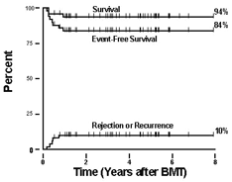
Outcome after HSCT for sickle cell anaemia. The survival, event-free survival and a cumulative incidence curve for graft rejection/recurrent sickle cell disease of fifty patients who had at least 6 months follow-up received matched sibling marrow
allografts between September 1991 and October, 1999.
Sullivan KM et al. Hematology 2000; 319-338.

Slide 47
After SCT for SCA
Bad news
CNS complications (25%)
- Stroke have been reported after SCT.
- Intracranial haemorrhage
- Seizures –most frequent
Second malignancies.
Growth failure
Primary gonadal failure in girls/infertility.

Slide 48
Conclusion
HSCT is an established therapy for NMDs in children.
Decision to transplant NMDs is complex and requires assessment of risk-benefit ratio.
Individual case assessment is important for transplant of NMDs in children.
Early decision to transplant can improve outcome of transplant and enhance good quality of life thereafter.

Slide 49
Who would you rather transplant?
1. A 12-year old with
- long-history of pain crises.
- Elevated transcranial doppler ultrasounds
- Chronic blood transfusion program
- Evidence of iron overload.
2. A 4-year old with
- 5 admissions/year for pain crisis
- Acute chest crisis.
- Matched sibling donor with sickle cell trait.

Slide 50
Who would you rather transplant?
3. 30-year old with
- Long-standing history of pain crises
- Sickle nephropathy.
- One previous stroke
- Pulmonary hypertension
- Multiple blood transfusions.
Alloimmunization.
AND WHY?

Slide 51
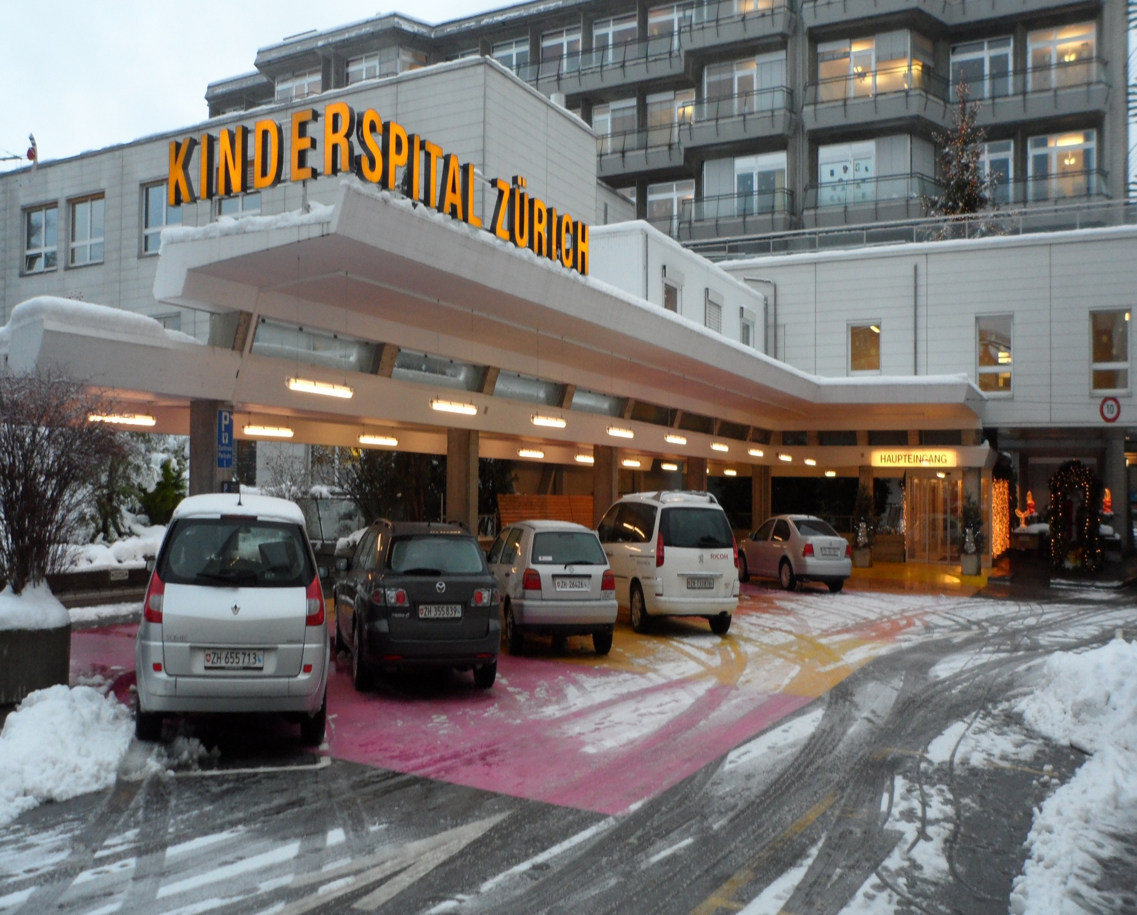

Slide 52
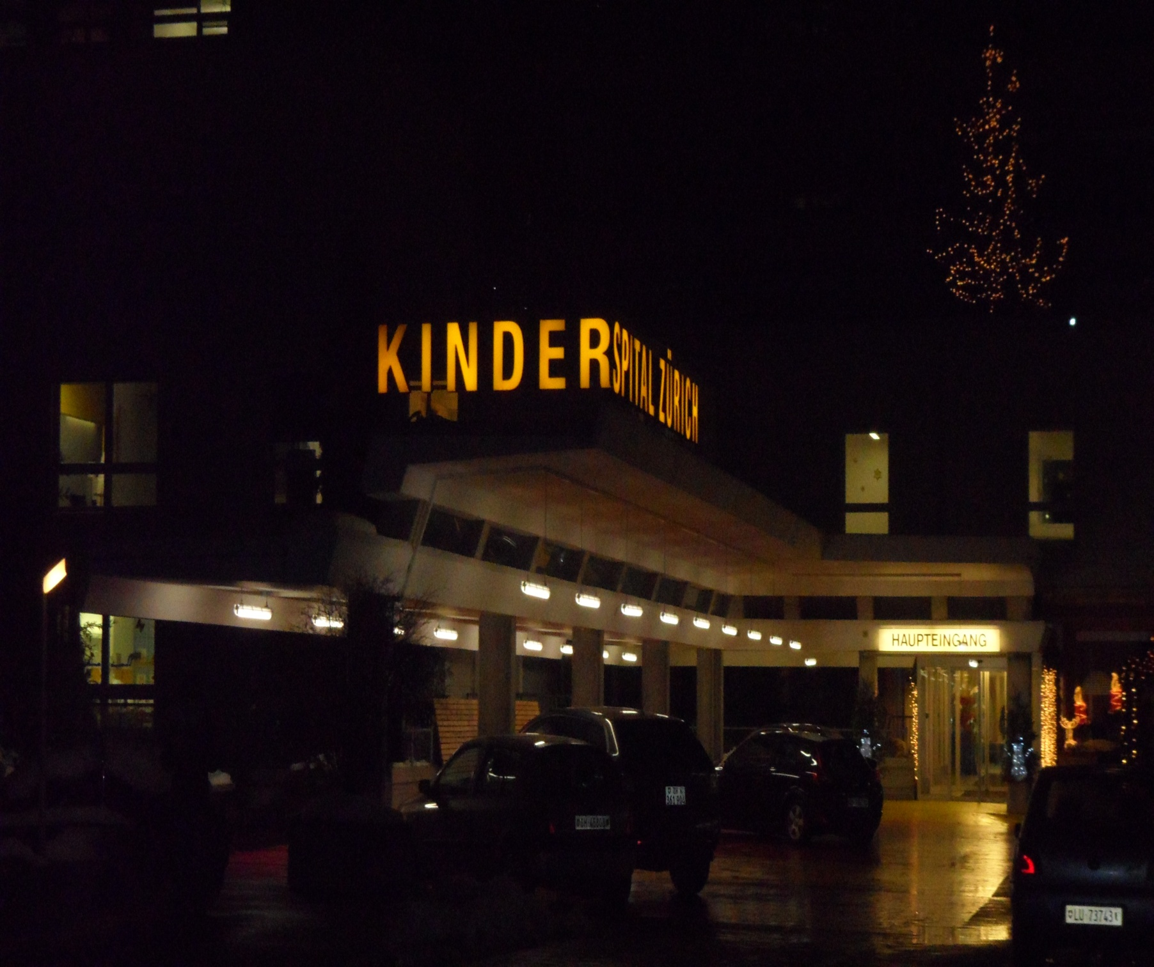
Kinderspital at 5pm in the evening-winter.

Slide 53
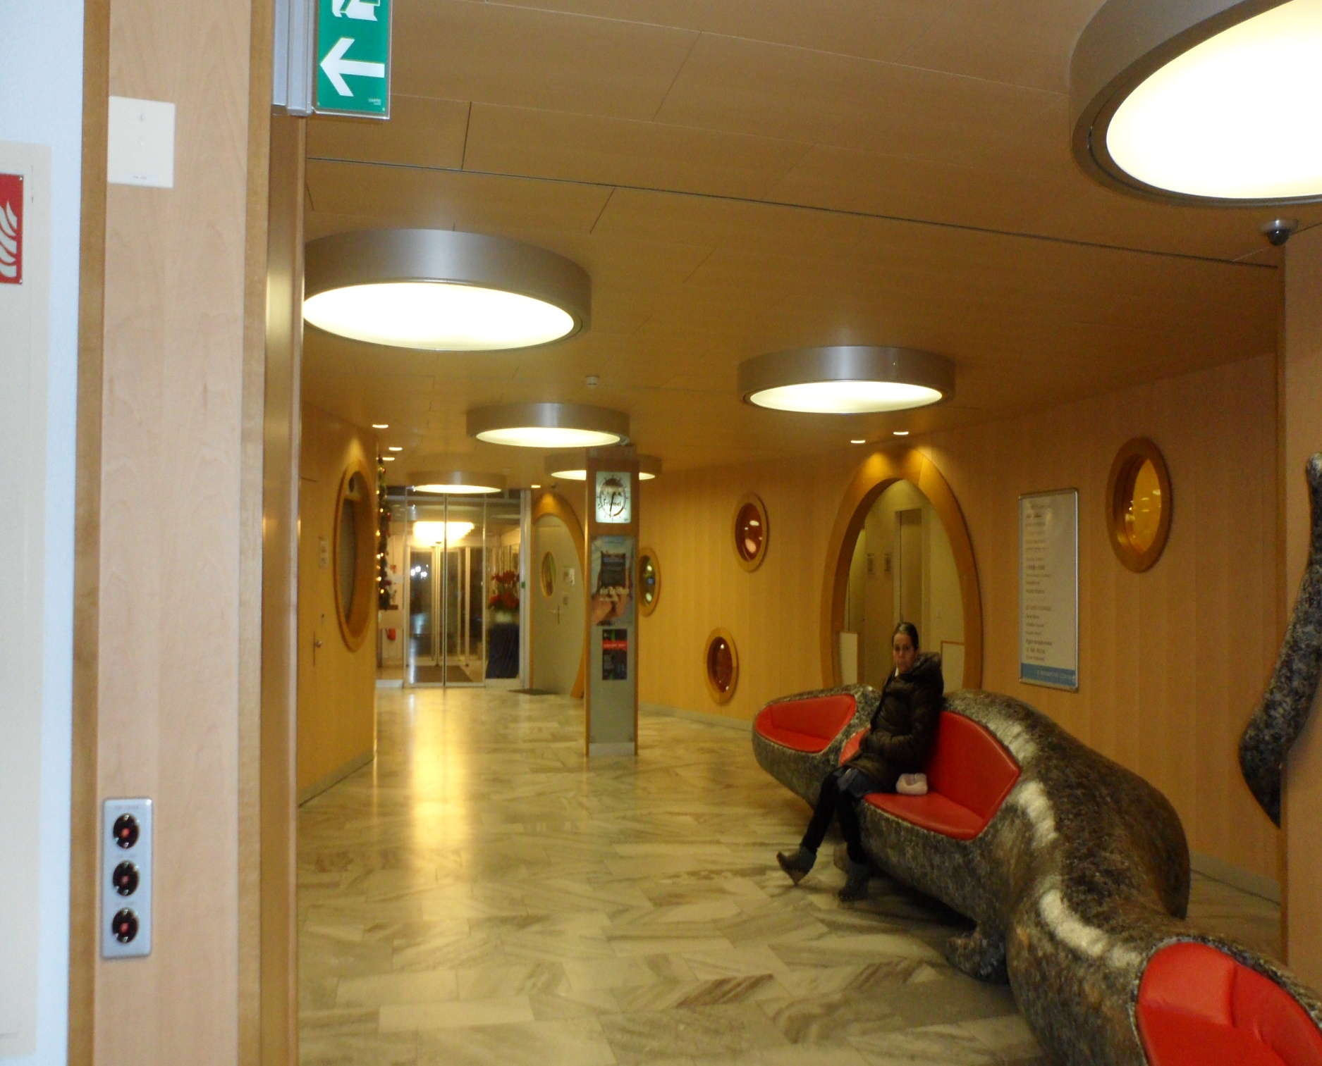

Slide 54
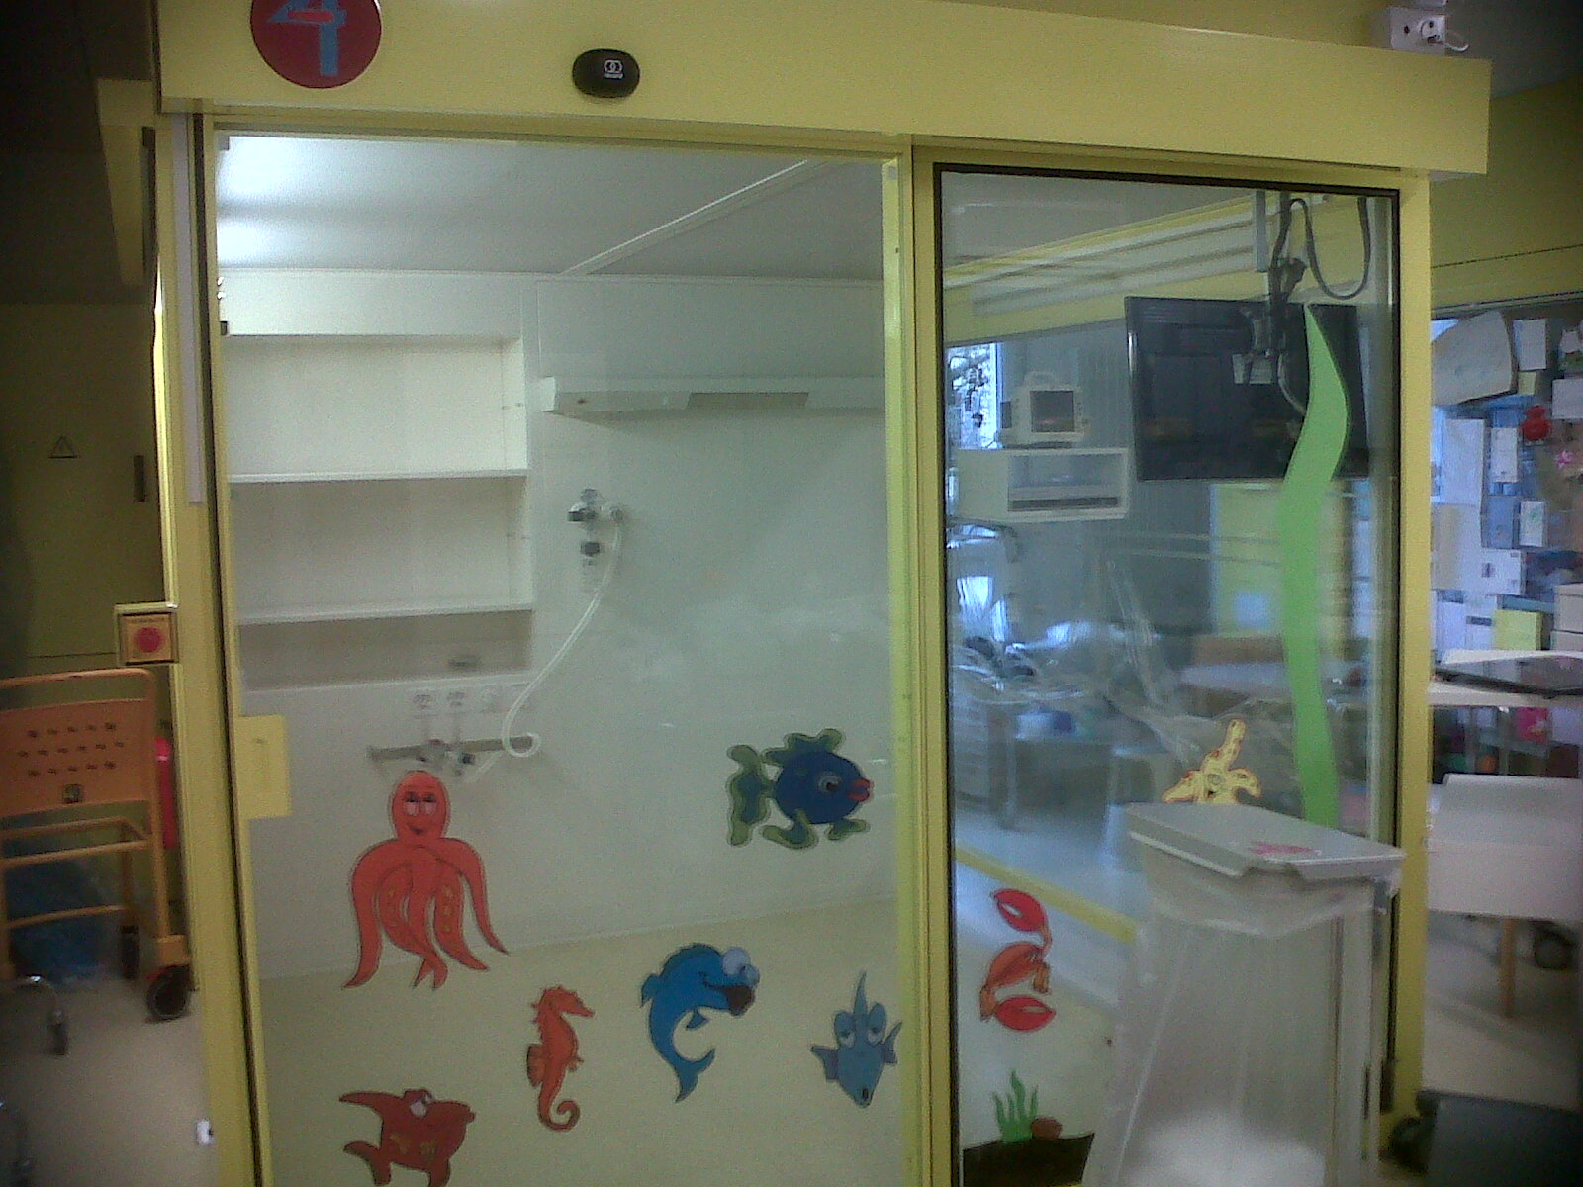

Slide 55
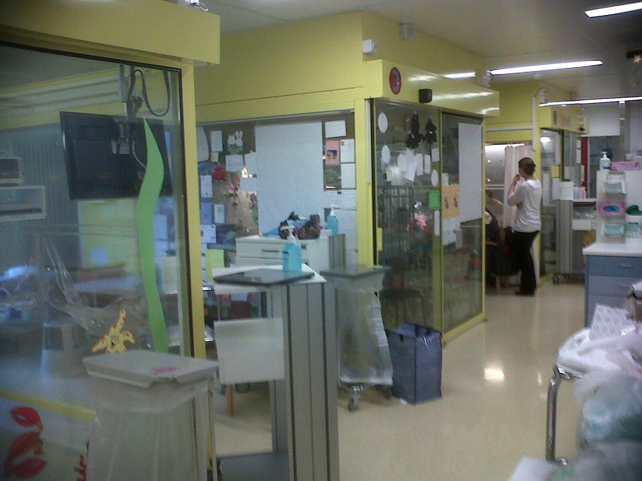

Slide 56
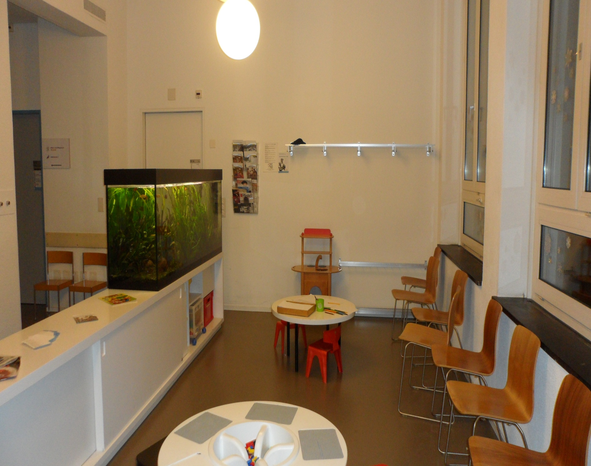

Slide 57
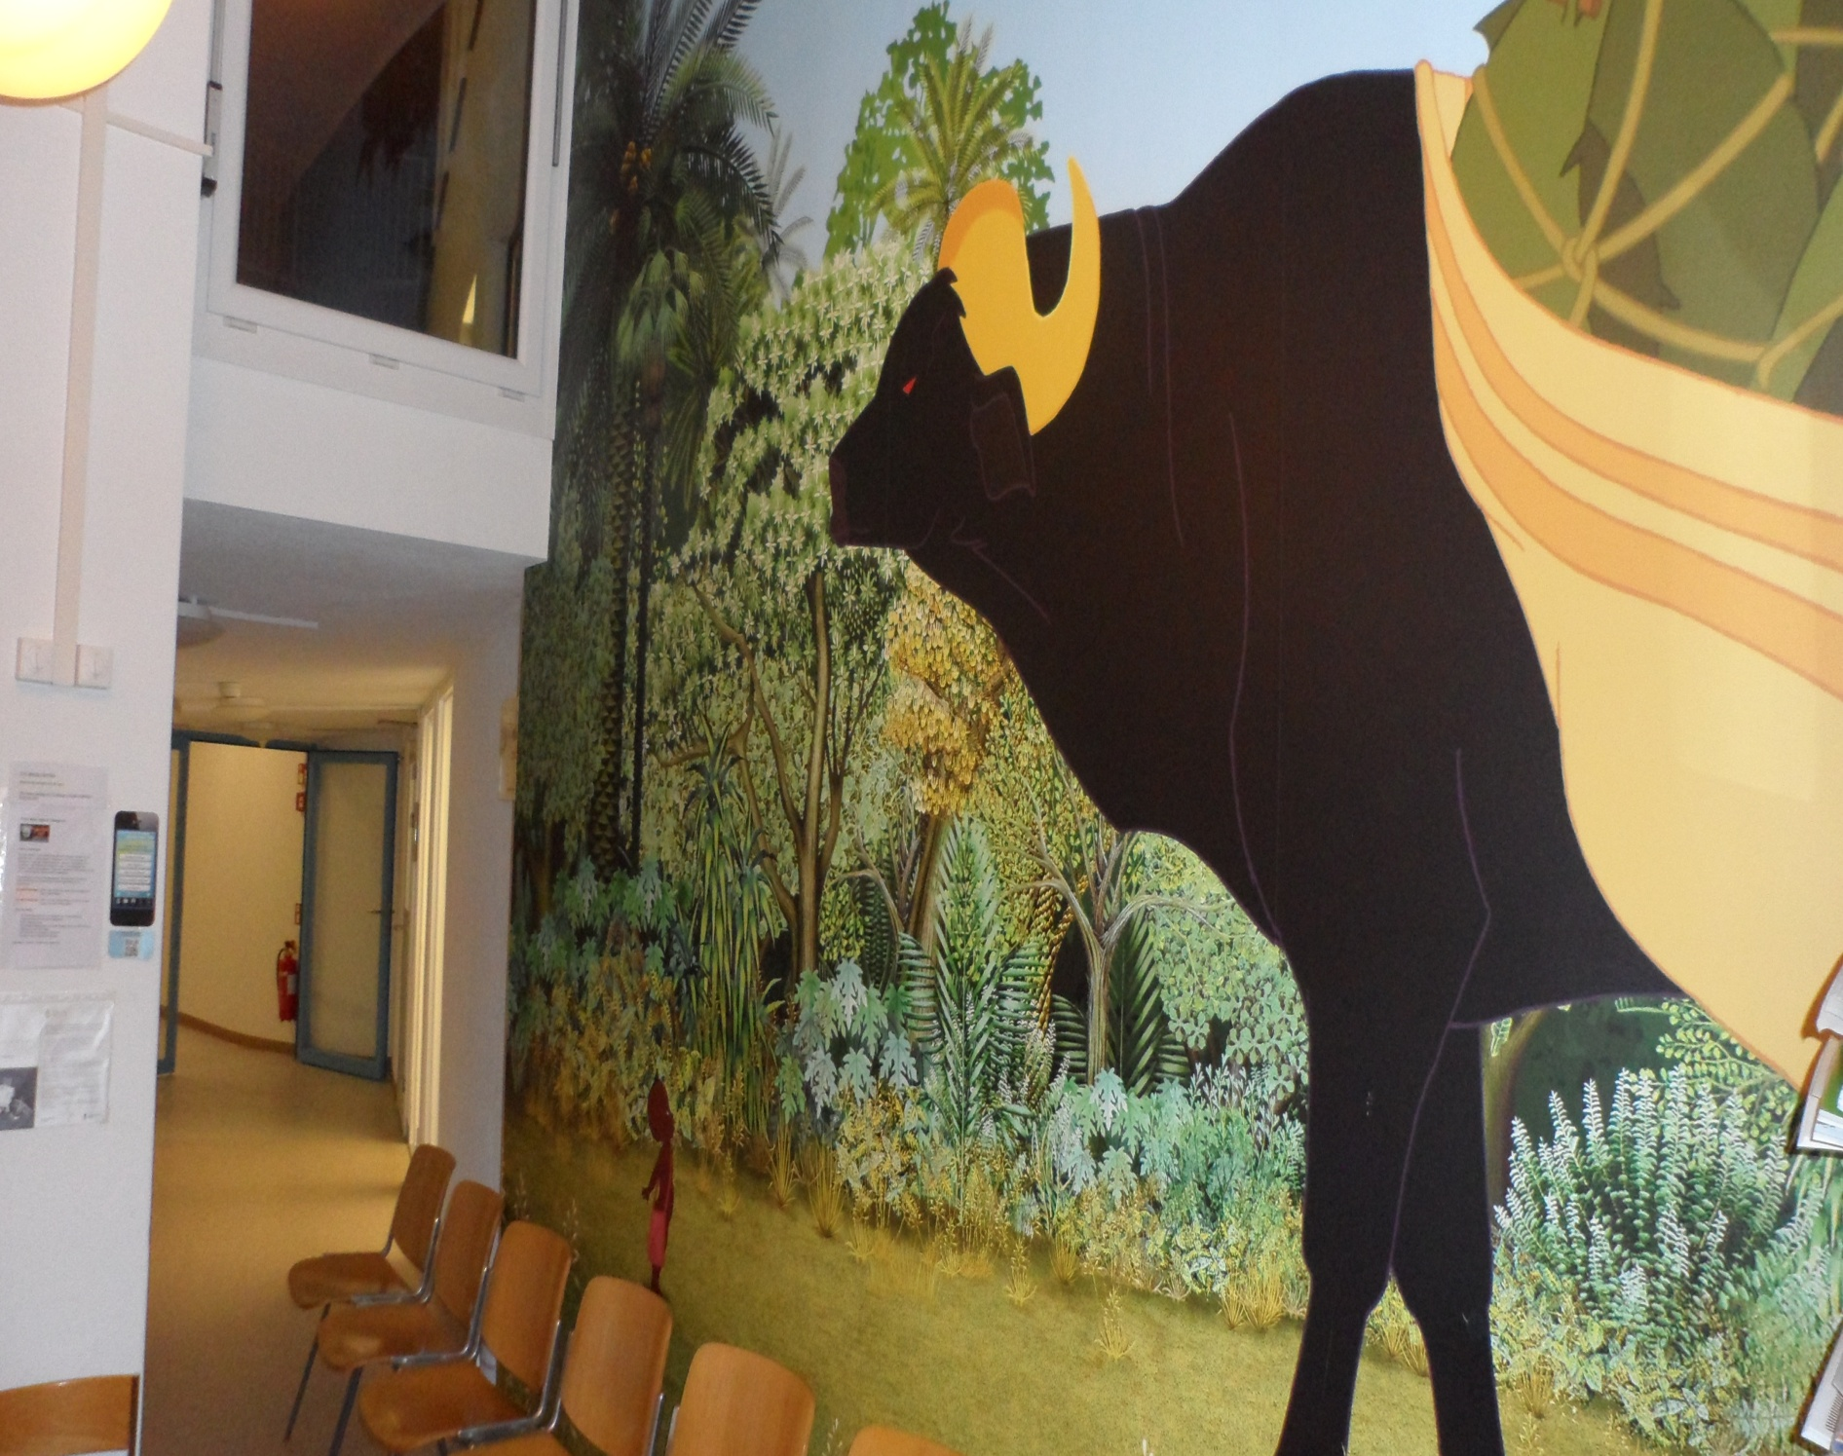

Slide 58
THANKS!!!

Slide 59
References
Shalini Shenoy. Hematopoietic Stem Cell Transplantation for Sickle Cell Disease: Current Practice and Emerging Trends. Hematology 2011; 273-279.
Kinney T, Sleeper L, Wang W, et al. Silent cerebral infarcts in sickle cell anemia: a risk factor analysis. The cooperative study of sickle cell disease. Pediatrics. 1999;103:640-545.
Cuvelier G. Allogeneic Hematopoietic Stem Cell Transplant for Non-Malignant Disorders. 2013 CBMTG Meeting.

Slide 60
References contd.
Sullivan KM, Parkman R, Walters MC. Bone marrow transplantation for non-malignant disease. doi:10.1182/asheducation2000.1.319
Horwitz ME. Stem cell transplantation for adults and children with sickle cell disease: progress at different pace. Available at www.hematology.org/Publications/Haematologist/2011/6624.aspx
Buckley RH, Schiff SE, Schiff RI, et al. Hematopoietic stem cell transplantation for the treatment of severe combined immunodeficiency. N Engl J Med. 1999;340:508-516.

Slide 61
References contd.
Ayas et al. Pediatr Blood Cancer 2011; 56:289-293.
- Woodard P, Helton K, Khan R, et al. Brain parenchymal damage after hematopoietic stem cell transplantation for severe
sickle cell disease. Br J Haematol. 2005;129: 550-552.
- Scothorn D, Price C, Schwartz D. Risk of recurrent stroke in children with sickle cell disease receiving blood transfusion therapy for at least five years after initial stroke. J Pediatr 2002;140:348-354.
-

Slide 62
References contd.
- Kalinyak K, Morris C, Ball W, Ris M, Harris R, Rucknagel D. Bone marrow transplantation in a young child with sickle cell anemia. Am J Hematol. 1995; 48: 256-261.
- Hsieh MM, Fitzhugh CD, Tisdale JF. Allogeneic hematopoietic stem cell transplantation for sickle cell disease: the time is now. doi:10.1182/blood-2011-01-332510.
Scothorn et al. J Pediatr 2002; 140; 348-54
Walters et al. BBMT 2010; 16: 263-272
Bernaudin et al. Blood 2007; 110: 2749-2756

