Slide 1
PRE-TRANSPLANT PROTOCOL
STEM CELL TRANSPLANT UNIT
UNIVERSITY OF BENIN TEACHING HOSPITAL

Slide 2
OUTLINE
INTRODUCTION
PRE-TRANSPLANT PROCESSES
OUR INDEX TRANSPLANT PROTOCOL
PRE-TRANSPLANT WORKUP:RECIPIENT
PRE-TRANSPLANT WORKUP:DONOR

Slide 3
INTRODUCTION
HSCT is therapeutic modality employed in a number of haematological and non-haematological disorders
It entails eradication of an individuals haemopoietic and immune system with cytotoxic chemotherapy and/or radiotherapy and subsequently reconstitution of the recipient’s system with healthy donor stem cells.

Slide 4
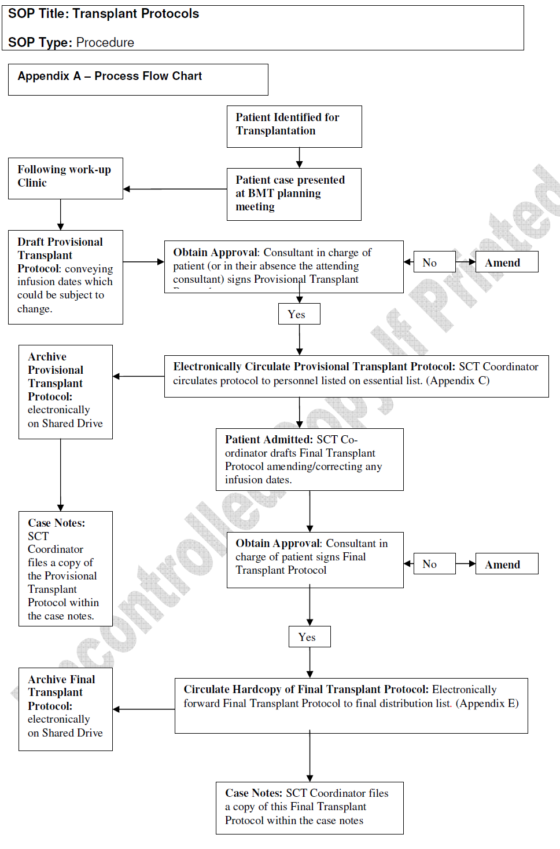

Slide 5
Chemotherapeutic drugs(BMT) Day
Name: Ebenezer |  | Surname: Matthew |  |  | Nurse |  | Doc 1 |  |  | Doc 2
Date of birth:23.11.1997 |  | Weight | 48 | kg
Diagnosis:Sickle Cell Disease |  | Height | 175 | cm
Ordinance created by: Iheanacho O E |  | BSA | 1.53 | m²
 | x /day | mg/kg | mg/m2 |  | total
Voriconazole IV | 2 | 6 |  |  | 240 | mg
Gentamycin IV | 2 | 2 |  |  | 80 | mg
Vancomycin IV | 4 | 10 |  |  | 400 | mg
Neomycin PO | 4 | 0.05 |  |  | 500 | mg
Heparin IV continuous infusion | continuous | 100 |  |  | 4000 | Units
Ranitidine IV | 1x | 1 |  |  | 40 | mg
Acyclovir (1500mg/m2/day) | 3x |  | 500 |  | 765 | mg
Rocephin IV (10mg/kg/d) | 1x (2x) | 10 |  |  | 480 | mg
Promethazine IV | 2-3x | 0.05 |  |  | 2.4 | mg
Paracetamol IV (10mg/kg/Dose) | 4x | 15 |  |  | 720 | mg
Albendazole | Stat |  |  |  | 400 | mg
Paludrine | 1x |  |  |  | 200 | mg
Fansidar | Stat
Chemotherapy (conditioning)
Busulfan | 4x | 14 |  |  |  | mg
Fludarabine |  |  |  |  |  | mg

Slide 6
SOP TITLE: PRE-SCT WORKUP: RECEPIENT WORK-UP
SOP TYPE: PROCEDURE
UNIVERSITY OF BENIN TEACHING HOSPITAL
STEM CELL TRANSPLANT UNIT
UGBOWO, BENIN CITY

Slide 7
PURPOSE: To ensure that all necessary pre-transplant evaluations are done. To provide evaluation procedures to assess the suitability of the patient to proceed to stem cell transplant (SCT).
Date received:
Prepared by:
Authorised by :
Number of pages:
Location :

Slide 8
CONTENT
PRE WORK-UP ADMINISTRATION
WORK-UP CLINIC
PRE ADMISSION ADMINISTRATION

Slide 9
PRE WORK-UP ADMINISTRATION
Selection of patient and donor
When a patient has been evaluated and deemed suitable by a consultant for allogeneic transplantation, efforts are made to identify a suitable donor.
This may involve the tissue-typing of any siblings and/or the initiation of an unrelated donor search.

Slide 10
FERTILITY ISSUES
Fertility issues should be addressed by the consultant who has decided that a patient is suitable for transplant.
Arrangements will be made for appropriate action.
Any decisions taken must be documented in the patient’s notes.

Slide 11
ADDITION OF PATIENT TO TRANSPLANT PLANNING LIST
The patient’s named consultant will carry out an initial patient assessment and refer to the SCT co-ordinator who will add the patient to the planning list.
The SCT co-ordinator will book the patient for work-up clinic which preferably should be at least four weeks before the proposed transplant date.

Slide 12
TBI (if required)
Provisional dates for total body irradiation (TBI) are made with the Radiotherapy department.
A TBI referral form must be sent to the Principal Physicist in Radiation Physics.

Slide 13
WORK-UP CLINIC
ROUTINE TESTS
A decision is to be made on source of stem cells to be used (i.e. bone marrow or peripheral blood). Make the necessary arrangements for their collection if not already available.
The SCT Manager will prepare a work-up checklist for allogeneic transplant.
Forms for ECG, chest X-ray and lung function test should be filled before the clinic.
Using the check-list, the Haematology unit doctor will be able to request the specified blood tests, bleed the patients and ensure that the bloods are packaged correctly and made ready for transport to the correct blood testing lab for testing.
In sibling allogeneic transplants, hard copy evidence of HLA match should have been obtained prior to putting the patient on the SCT list but HLA tissue typing must be checked again on fresh blood samples.

Slide 14
MEDICAL INTERVIEW TO INCLUDE OBTAINING CONSENT FOR SCT
The Allogeneic SCT Co-ordinator will discuss all aspects of the transplant procedure, the complications of SCT and the likely outcome with the patient (and relatives if the patient wishes).
He/she will obtain written informed consent for the BMT.
The patient will then be asked to sign the Patient Consent to Stem Cell Transplantation Form

Slide 15
PSYCHOSOCIAL INTERVIEW
The patient and relatives will be interviewed by one of the Clinical Nurse Specialists and issues bothering on catheter, chemotherapy, radiotherapy, isolation/hygiene/skin care, mucositis/oral/dental care, sickness and diarhoea, diet/nutrition/feeding, medications, risk of dying, fertility/sexuality/HRT, coping, discharge, follow-up, chronic problems, relapse/treatment failure, carers and visitors, hair loss(wigs), smoking etc, should be discussed.

Slide 16
DIETETIC INTERVIEW
The dietician will interview the patient in the clinic.
RADIOTHERAPY PLANNING
If the patient is to have TBI, the Principal Physicist should review at one of the work-up visits.
The Consultant Oncologist or their registrar will obtain consent (standard hospital consent form).

Slide 17
PATIENT TRANSPLANT PROTOCOL
The Allogeneic SCT Co-ordinator will prepare a patient transplant protocol which must be seen and sanctioned by the patient’s named consultant.
A copy of the protocol is put in the patient’s notes and distributed to all relevant personnel.
ORDER CHEMOTHERAPY
The Allogeneic SCT Co-ordinator will complete a prescription sheet for the chemotherapy and attach to the patient’s notes prior to admission and send a copy to the pharmacy.

Slide 18
BOOK CVC
The BMT Manager will book a date for insertion of central venous line with the cardio-thoracic surgery department and ensure that the request form is completed.
BLOOD TRANSFUSION REQUIREMENTS
The Allogeneic SCT Co-ordinator will complete a special transfusion requirement form

Slide 19
PRE-ADMISSION ADMINISTRATION
UNRELATED DONOR
The Allogeneic SCT Co-ordinator should make necessary arrangements to confirm donor clearance, harvest dates, the time of arrival of donor cells
SIBLING DONOR
The Allogeneic SCT Co-ordinator should ensure that all arrangements have been made for sibling donor harvest

Slide 20
OUTSTANDING TEST RESULTS
Any outstanding results from the work-up clinic should have been checked and put in the patient’s notes.
The original diagnosis of disease must also be confirmed by histology or histopathology.
The tissue typing of patient and donor will be confirmed.

Slide 21
BOOK PATIENT SCT ADMISSION
An Admission Booking form must be completed by the Allogeneic SCT Coordinator with proposed date of admission for transplant
Ensure patient and staff (both medical and nursing) are aware of proposed admission date.
PATIENT TRANSPLANT PROTOCOL
The Allogeneic SCT Co-ordinator will prepare a patient transplant protocol which must be seen and sanctioned by the patient’s named consultant.
A copy of the protocol is put in the patient’s notes and distributed to all relevant personnel.

Slide 22
COMPLETE PRE-ALLO SCT CHECKLIST
The Allogeneic SCT Co-ordinator will complete the Pre-Allo SCT checklist prior to admission

Slide 23
CHECKLIST FOR ALLOGENEIC TRANSPLANT WORKUP --RECIPIENT
ALL TESTS MUST BE DONE PATIENTS ID: WORK UP DATE:
TEST REQUIRED | COMMENT | SIGNATURE/DATE
FBC/ESR
COAGULATION PROFILE
E/U/Cr PROFILE
LFT
PBF
BLOOD TYPE
CALCIUM/PHOSPHATE
MAGNESIUM
URIC ACID
BLOOD FILM FOR MP
HB ELECTROPHORESIS
THYROID FXN TEST
TESTOSTERONE(M)
OESTRADIOL(F)
CMV SEROLOGY(Ig G/M)
HIV 1 AND 2
HTLV1 AND 2
HBSAG
ANTI-HBV CORE Ig G/M
HEP. C AB (ELISA)
SYPHILIS SCREEN
COOMBS TEST
FULL HLA TYPING
CXR
ABDOMINAL USS
ECHO
ECG
WHOLE BODY CT SCAN

Slide 24
SOP TITLE: PRE TRANSPLANT WORKUP: ALLOGENEIC DONOR
SOP TYPE: PROCEDURE
UNIVERSITY OF BENIN TEACHING HOSPITAL
STEM CELL TRANSPLANT UNIT
UGBOWO, BENIN CITY

Slide 25
PURPOSE: To ensure that all necessary procedures and tests are carried out from patient selection for transplant through to the admission for transplant. To provide evaluation procedures to assess the suitability of the donor for mobilisation and stem cell collection or bone marrow harvest.
Date received:
Prepared by:
Authorised by:
Number of pages:
Location:

Slide 26
CHECKLIST FOR ALLOGENEIC TRANSPLANT WORKUP --DONOR
ALL TESTS MUST BE DONE PATIENTS ID: WORK UP DATE:
TEST REQUIRED | COMMENT | SIGNATURE/DATE
FBC/ESR
COAGULATION PROFILE
E/U/Cr PROFILE
LFT
PBF
BLOOD TYPE
CALCIUM/PHOSPHATE
MAGNESIUM
URIC ACID
BLOOD FILM FOR MP
HB ELECTROPHORESIS
THYROID FXN TEST
TESTOSTERONE(M)
OESTRADIOL(F)
CMV SEROLOGY(Ig G/M)
HIV 1 AND 2
HTLV1 AND 2
HBSAG
ANTI-HBV CORE Ig G/M
HEP. C AB (ELISA)
SYPHILIS SCREEN
COOMBS TEST
FULL HLA TYPING
CXR
ABDOMINAL USS
ECHO
ECG
WHOLE BODY CT SCAN

Slide 27
Thank you

